Slide 1
Controlling Singular Values with Semidefinite Programming
Shahar Kovalsky*, Noam Aigerman*, Ronen Basri and Yaron Lipman Weizmann Institute of Science
* equal contributors

Slide 2
Singular Values
$$A$$
$$σ_{2}$$
$$σ_{4}$$
$$σ_{1}$$
$$σ_{3}$$
$$σ_{5}$$

Slide 3
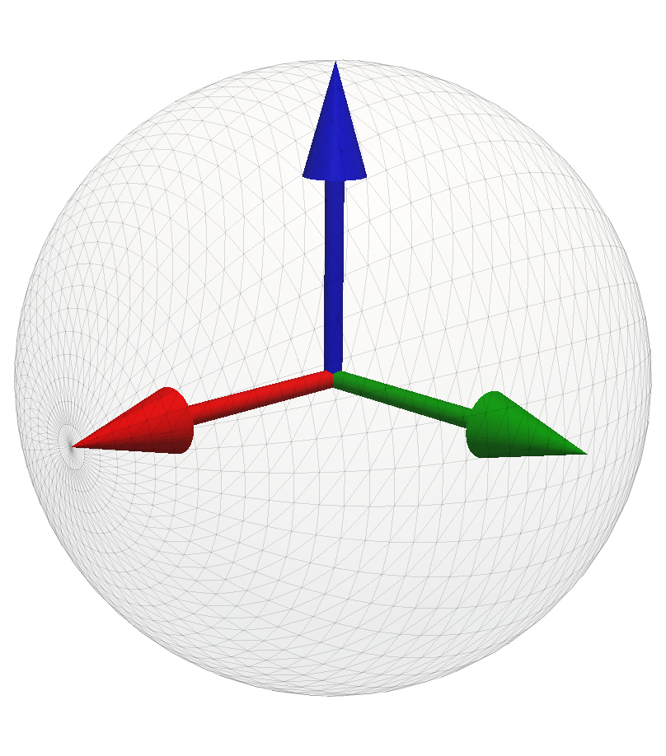
Singular Values
$$A$$
$$σ_{min}$$
$$σ_{max}$$

Slide 4
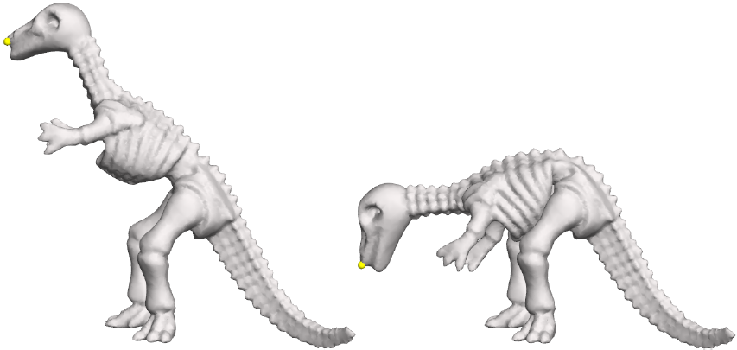
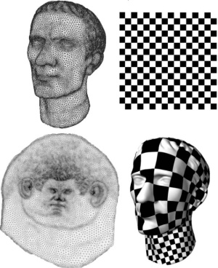
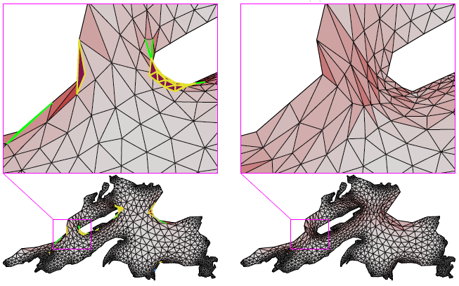
Motivation
As-Rigid-As-Possible
Least Squares
Conformal Mappings
[Sorkine and Alexa 2007]
Bounded Distortion Mappings
[Lévy et al. 2002]
[Lipman 2012]

Slide 5
Common Perspective
Optimization of linear transformations = Matrices
Explicitly involving singular values
Constraints
Energies
This Work

Slide 6
Constrained Matrix Optimization
$\begin{matrix}\min_{A∈ℝ^{n×n}} & f\left(A\right) \\ s.t. & g_{i}\left(A\right)≤0 \end{matrix}$
Energy
$${\left\|A−R_{A}\right\|}_{F}$$
Constraints
$Ax=y$
$A^{T}A=I$
$\det\left(A\right)>0$
$$x$$
$$y$$
$$A=\left(A_{1},…,A_{m}\right)$$

Slide 7
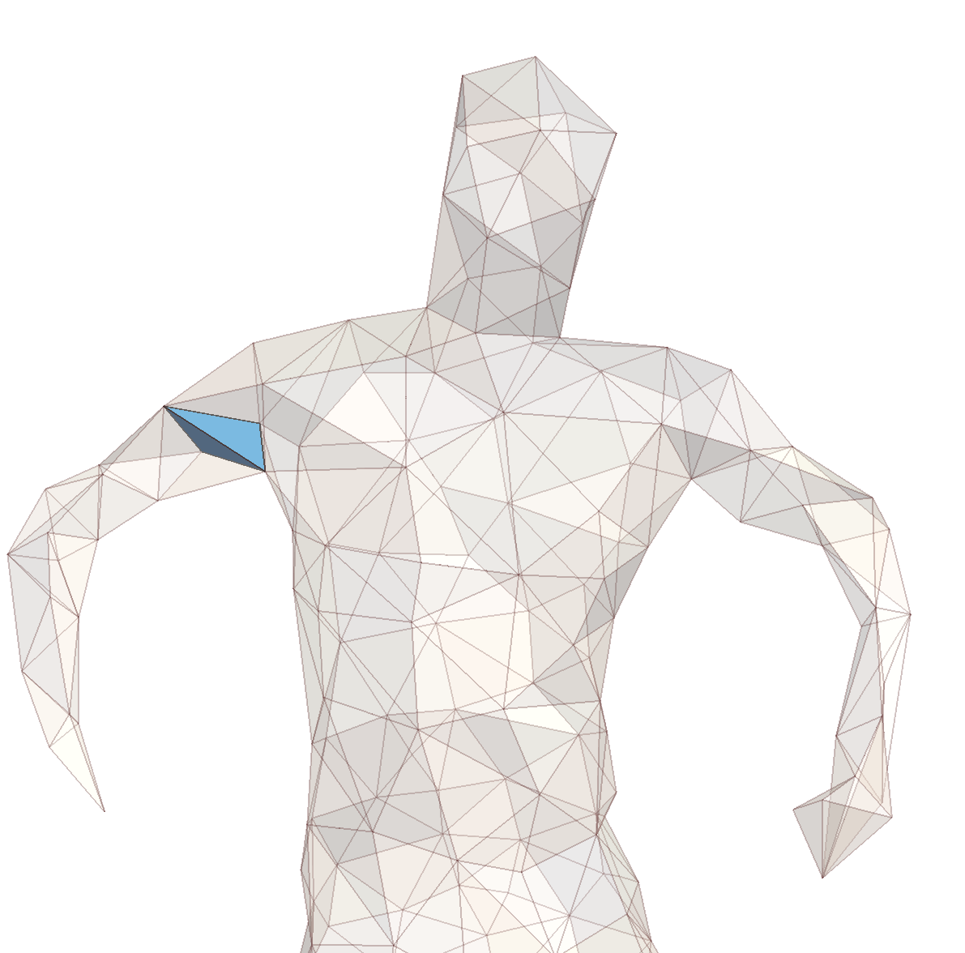
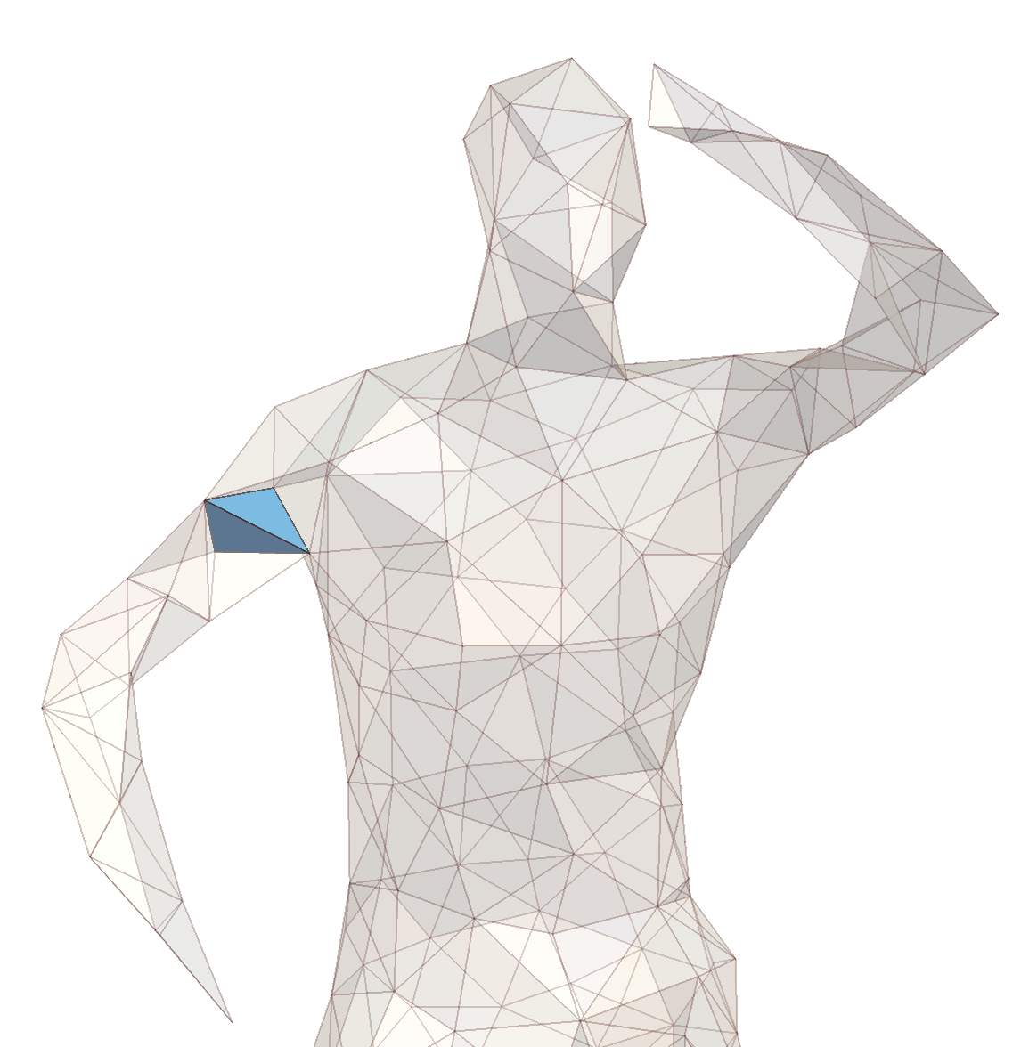
Constrained Matrix Optimization
$$Φ\left(x\right)=A_{i}x+t_{i}$$

Slide 8
Optimization of Singular Values
$\begin{matrix}\min_{A∈ℝ^{n×n}} & f\left(A\right) \\ s.t. & g_{i}\left(A\right)≤0 \end{matrix}$
Directly optimize singular values $σ_{1},…,σ_{n}$
Energy
Constraints

Slide 9
This Work
$$\min_{A∈ℝ^{n×n}}$$ | $$f\left(A,σ_{min}\left(A\right),σ_{max}(A)\right)$$
$$s.t.$$ | $$g_{i}\left(A,σ_{min}\left(A\right),σ_{max}(A)\right)≤0$$
Optimization problems explicitly expressed in terms of extremal SVs
Challenging
Non-linear
Non-convex
No closed form

Slide 10
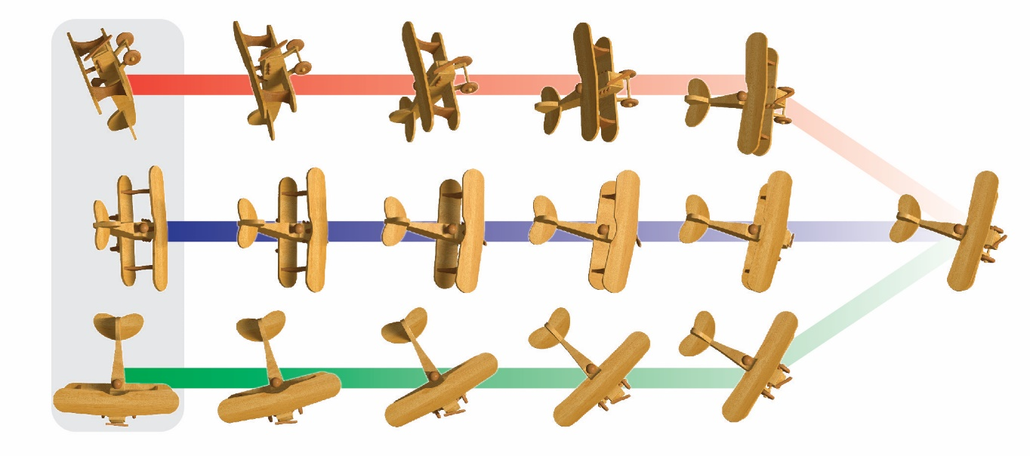
This Work
$$\min_{A∈ℝ^{n×n}}$$ | $$f\left(A,σ_{min}\left(A\right),σ_{max}(A)\right)$$
$$s.t.$$ | $$g_{i}\left(A,σ_{min}\left(A\right),σ_{max}(A)\right)≤0$$
Optimization problems explicitly expressed in terms of extremal SVs

Slide 11
Key Results
$$\min_{A∈ℝ^{n×n}}$$ | $$f\left(A,σ_{min}\left(A\right),σ_{max}(A)\right)$$
$$s.t.$$ | $$g_{i}\left(A,σ_{min}\left(A\right),σ_{max}(A)\right)≤0$$
Can be reduced to
$$γ≤σ_{min}\left(A\right)≤σ_{max}\left(A\right)≤Γ$$
Non-convex
Convex
$$Γ$$
$$γ$$

Slide 12
Key Results
$$\min_{A∈ℝ^{n×n}}$$ | $$f\left(A,σ_{min}\left(A\right),σ_{max}(A)\right)$$
$$s.t.$$ | $$g_{i}\left(A,σ_{min}\left(A\right),σ_{max}(A)\right)≤0$$
Can be reduced to
$$γ≤σ_{min}\left(A\right)≤σ_{max}\left(A\right)≤Γ$$
Semidefinite Programming (SDP)
Optimal in the convex regime

Slide 13
Key Results
Semidefinite Programming (SDP)
SDP $⇔$ optimization with $≽$ constraints
$A≽0$ $⇔$ $A$ is positive semidefinite
The natural class for dealing with singular values
SDP
SOCP
QP
LP

Slide 14
Bounding SVs from above
$$\left(\begin{matrix}ΓI & A \\ A^{T} & ΓI\end{matrix}\right)≽0$$
$$σ_{max}\left(A\right)≤Γ$$
convex
(operator norm)

Slide 15
Bounding SVs from below
$$γ≤σ_{min}\left(A\right)$$
non-convex
cut a convex subset?

Slide 16
Bounding SVs from below
$$A$$
$$+$$
Symmetric
Anti-symmetric

Slide 17
Bounding SVs from below
$$γ≤σ_{min}\left(\frac{A+A^{T}}{2}\right)$$
$$γ≤σ_{min}\left(A\right)$$
$$+$$
Symmetric
Anti-symmetric

Slide 18
Bounding SVs from below
$$γ≤σ_{min}\left(\frac{A+A^{T}}{2}\right)$$
$$γ≤σ_{min}\left(A\right)$$

Slide 19
Bounding SVs from below
$$\frac{A+A^{T}}{2}−γI≽0$$
$$γ≤σ_{min}\left(A\right)$$
maximal convex subset

Slide 20
Maximal Convex Cover
$$\frac{A+A^{T}}{2}−γI≽0$$
$$γ≤σ_{min}\left(A\right)$$
maximal convex cover

Slide 21
Our Key Result
$$γ≤σ\left(A\right)≤Γ$$
$$\left(\begin{matrix}ΓI & A \\ A^{T} & ΓI\end{matrix}\right)≽0$$
$$\frac{A+A^{T}}{2}−2γI≽0$$
Convex-Optimal maximal convex cover
SDP
Semidefinite Programming

Slide 22
Our Key Result
$$\left(\begin{matrix}ΓI & A \\ A^{T} & ΓI\end{matrix}\right)≽0$$
[Lipman 2012]
Specific to 2D $⇒$ SOCP
Ours
Any dimension $⇒$ SDP
$$\frac{A+A^{T}}{2}−2γI≽0$$
maximal convex
cover
Semidefinite Programming
(SDP)

Slide 23
Optimization with SV constraints
Start with feasible $A$
$$A$$

Slide 24
Optimization with SV constraints
Start with feasible $A$
Repeat:
Optimize over a maximal convex restriction (SDP)
$$A$$
$$A$$

Slide 25
Optimization with SV constraints
Start with feasible $A$
Repeat:
Optimize over a maximal convex restriction (SDP)
Update rotation (centering)
$$A$$

Slide 26
Optimization with SV constraints
Start with feasible $A$
Repeat:
Optimize over a maximal convex restriction (SDP)
Update rotation (centering)
$$A$$

Slide 27
Optimization with SV constraints
Start with feasible $A$
Repeat:
Optimize over a maximal convex restriction (SDP)
Update rotation (centering)
$$A$$

Slide 28
Optimization with SV constraints
Start with feasible $A$
Repeat:
Optimize over a maximal convex restriction (SDP)
Update rotation (centering)
Every iteration
energy decreases
guaranteed feasibility
$$A$$

Slide 29
Optimization with SV constraints
Start with feasible $A$
Repeat:
Optimize over a maximal convex restriction (SDP)
Update rotation (centering)
$$A$$

Slide 30
Optimization with SV constraints
Start with feasible $A$
Repeat:
Optimize over a maximal convex restriction (SDP)
Update rotation (centering)
$$A$$

Slide 31
Optimization with SV constraints
Start with feasible $A$
Repeat:
Optimize over a maximal convex restriction (SDP)
Update rotation (centering)
Algorithm converges
Preserves sign of determinant
$\det\left(A\right)>0$ $⇔$ Orientation preserving
$$A$$

Slide 32
Applications

Slide 33
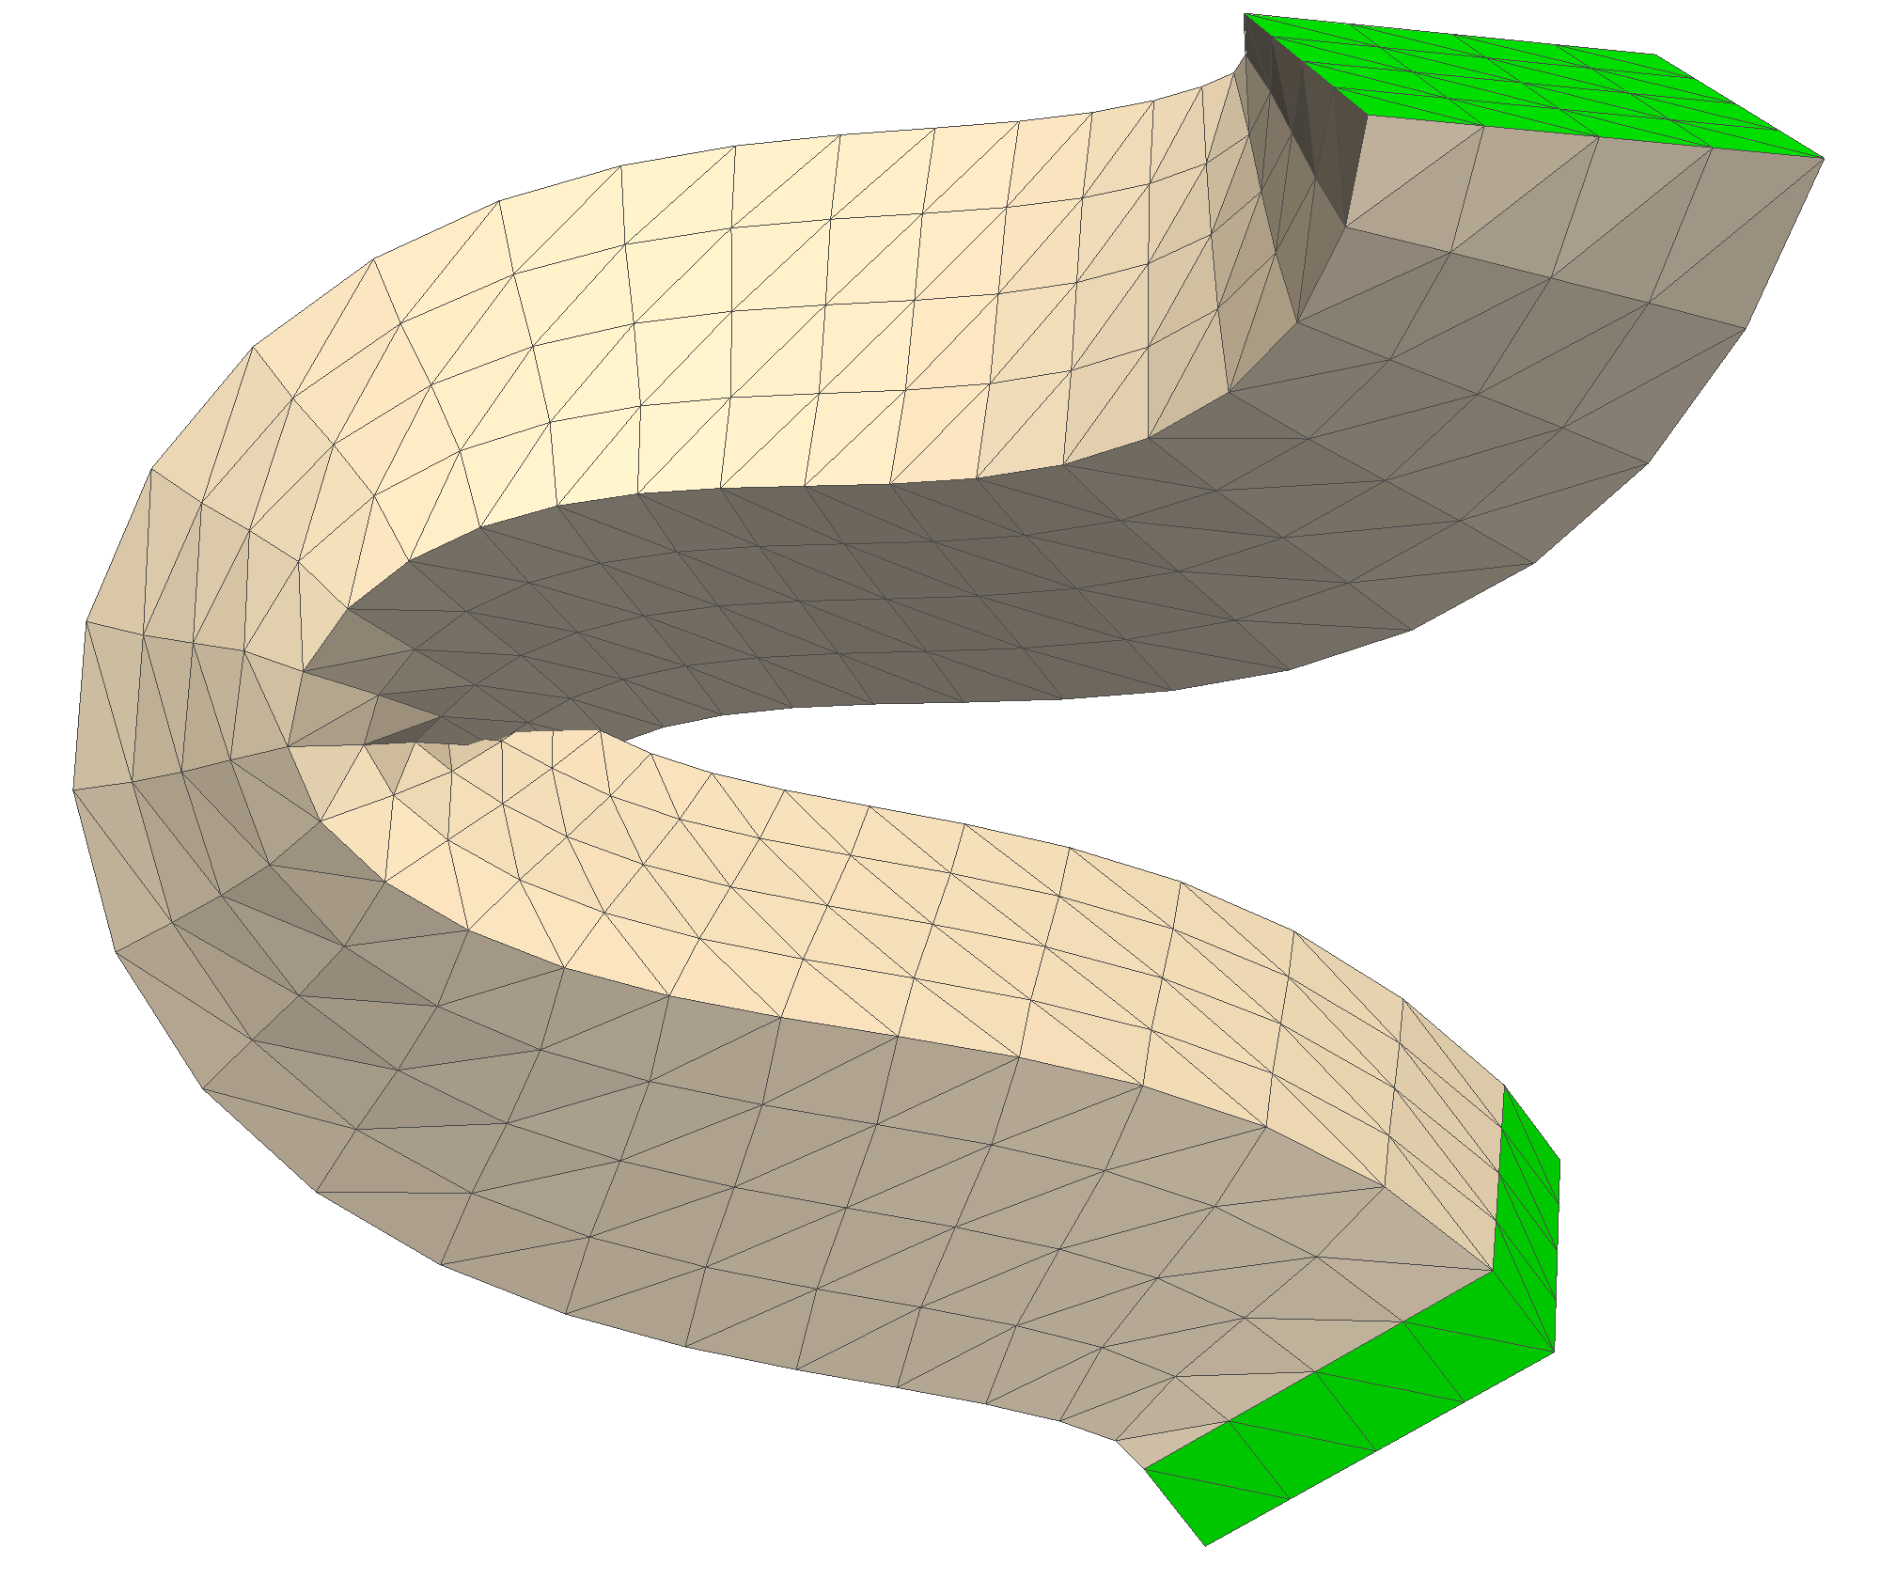
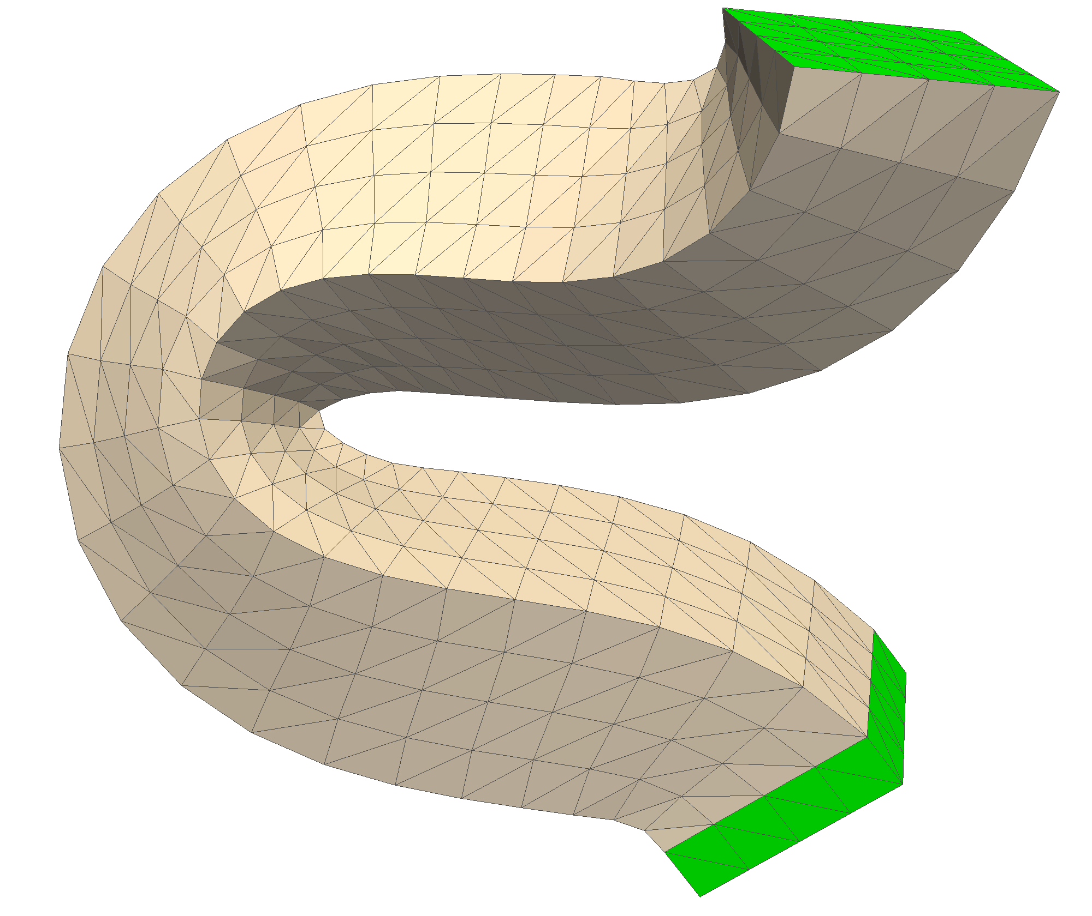
Shape Deformations
As-Rigid-As-Possible [Sorkine2007]
No flips!
Add constraint on SVs
$$\frac{σ_{max}(A_{i})}{σ_{min}\left(A_{i}\right)}≤2$$
Bounded Conformal
Distortion
Unconstrained

Slide 34
Extremal Quasiconformal Mappings
$$\underset{}{minimize}\left(\max_{i}{\frac{σ_{max}(A_{i}) }{σ_{min}\left(A_{i}\right)}}\right)$$
$$\frac{σ_{max}(A_{i}) }{σ_{min}\left(A_{i}\right)}$$

Slide 35
Extremal Quasiconformal Mappings
$$\underset{}{minimize}\left(\max_{i}{\frac{σ_{max}(A_{i}) }{σ_{min}\left(A_{i}\right)}}\right)$$
“Most Conformal Mapping”
Well studied in 2D [Weber et al. 2012]
Little known in 3D…
histogram of distortions

Slide 36
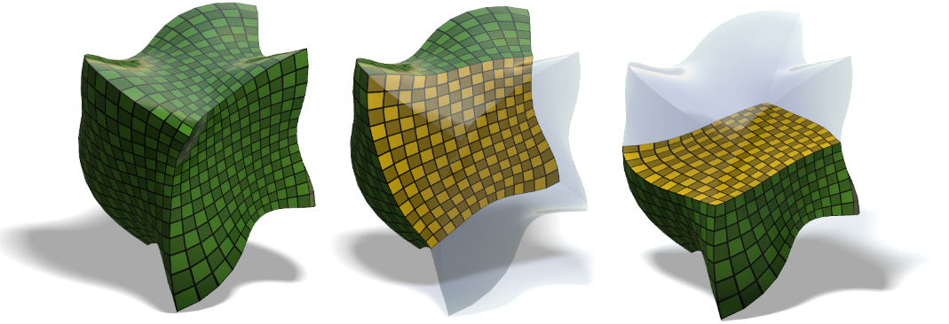
Extremal Quasiconformal Mappings
Approximate solution using our framework

Slide 37
Extremal Quasiconformal Mappings

Slide 38
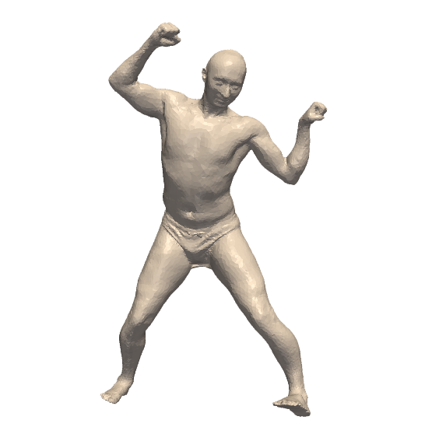
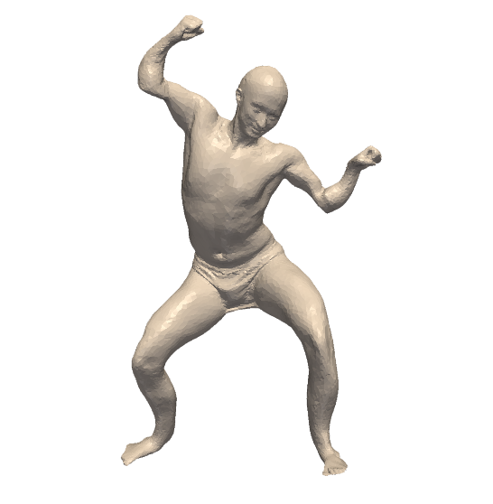
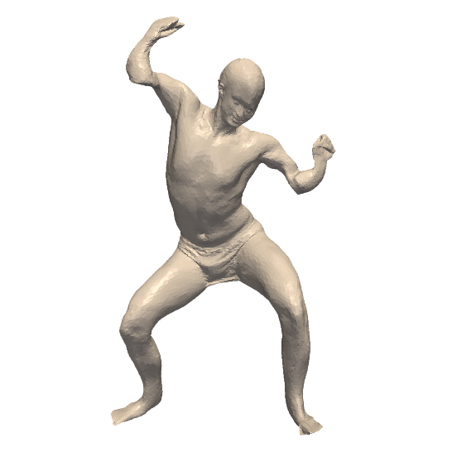
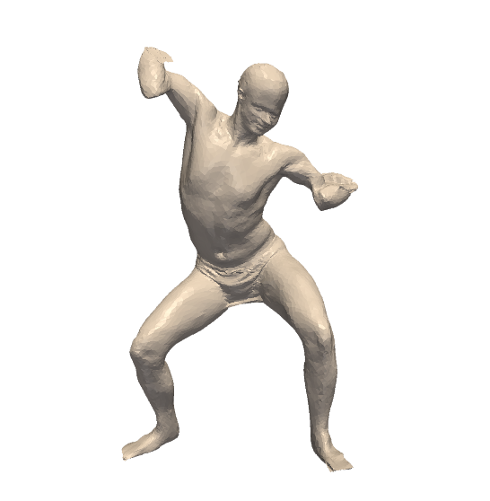
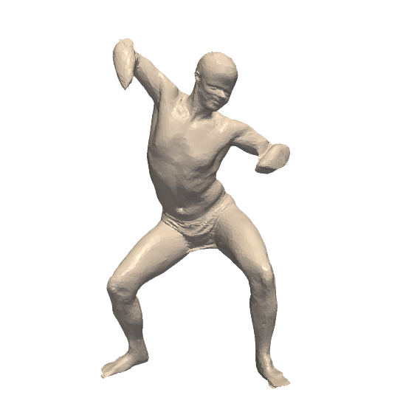
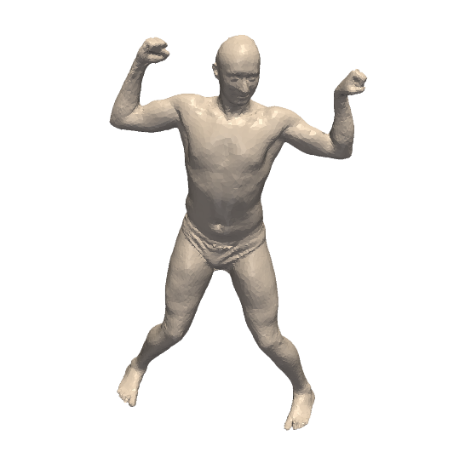
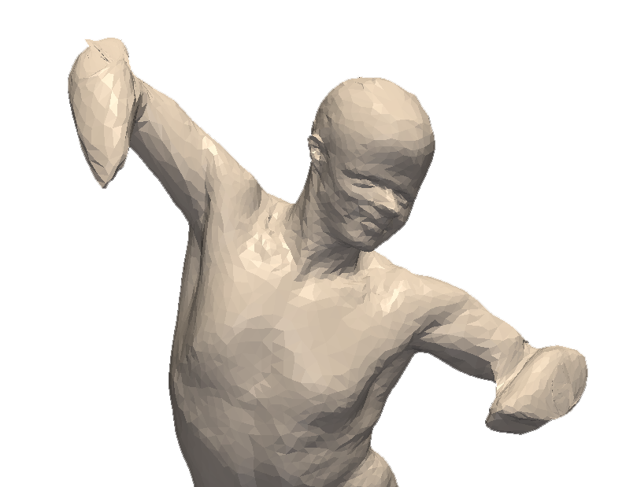
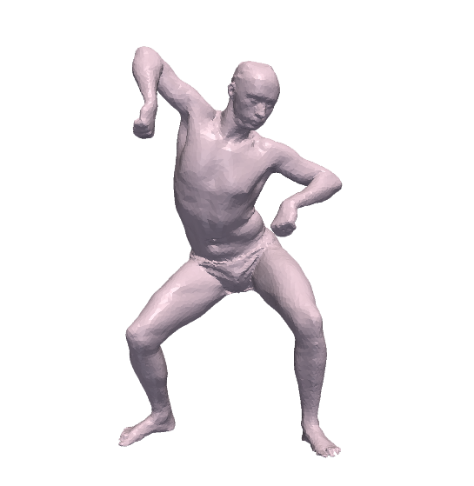
Non-Rigid 3D ICP
Regularization

Slide 39
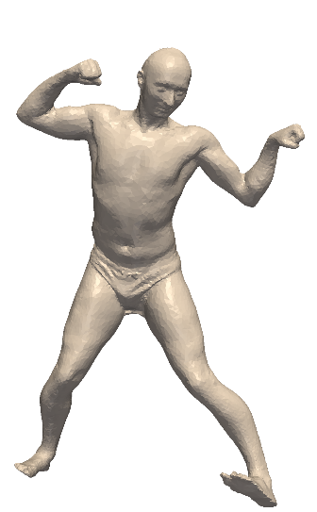
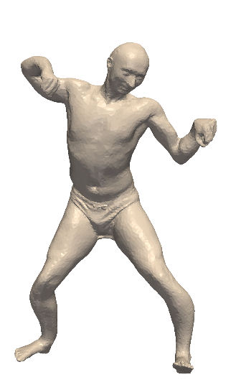
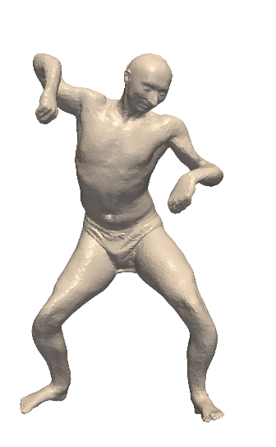
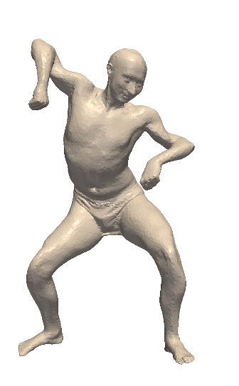
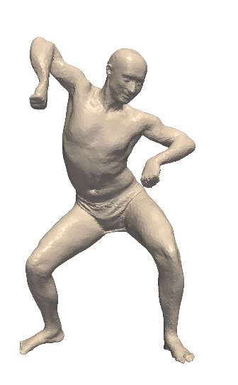
Non-Rigid 3D ICP
Regularization
Bounded Isometric Distortion

Slide 40
Non-Rigid 3D ICP

Slide 41
Non-Rigid 3D ICP

Slide 42
Interpolating Rotations
$$SO\left(3\right)$$

Slide 43
Interpolating Rotations
$$min$$ | $$| |$$
$$s.t.$$ | $$σ_{min}\left( \right)≥1$$
$$SO\left(3\right)$$

Slide 44
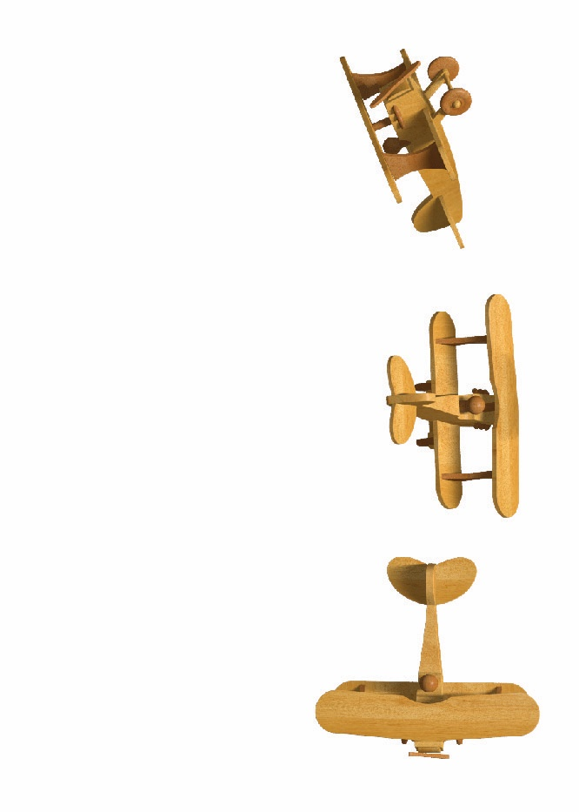
Averaging Rotations

Slide 45
Averaging Rotations

Slide 46
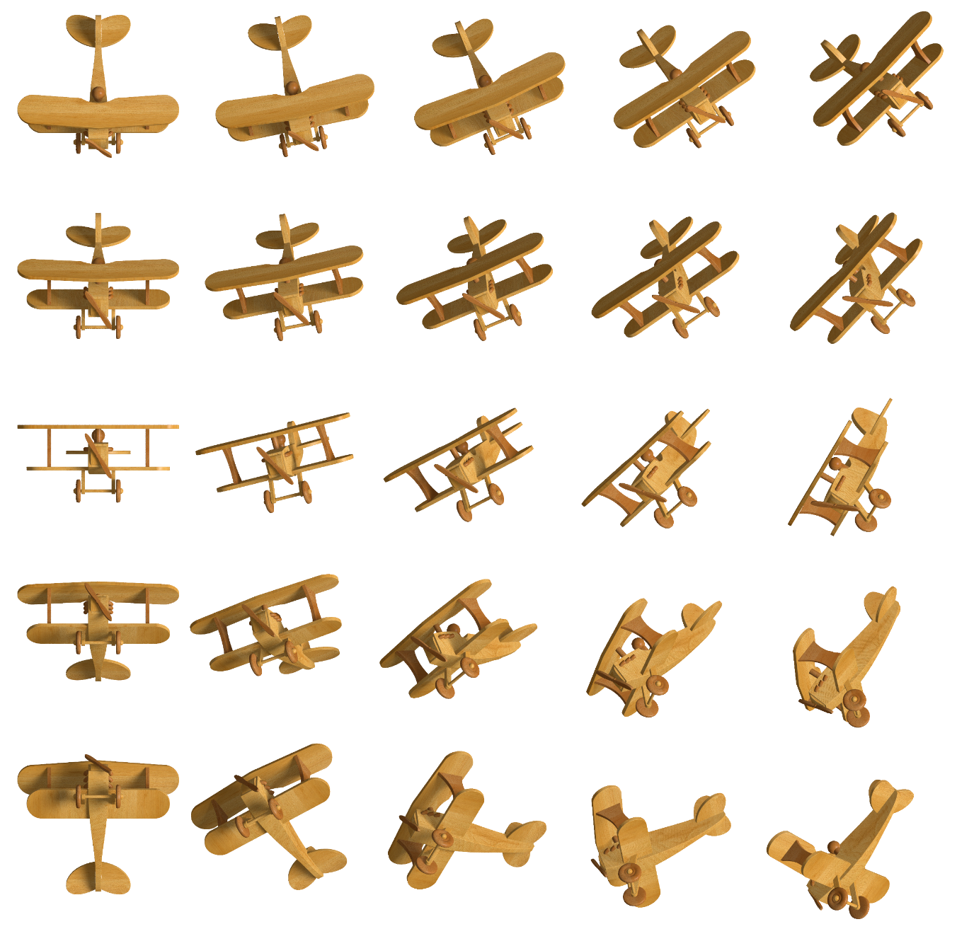
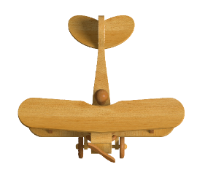
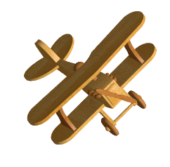
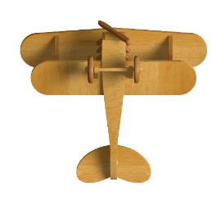
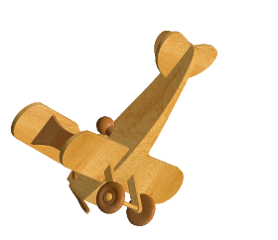
Interpolating Rotations

Slide 47
Concluding Remarks
Method for optimizing
Based on SDP
Optimal in the convex regime
Main limitation: time complexity
$$\min_{A∈ℝ^{n×n}}$$ | $$f\left(A,σ_{min}\left(A\right),σ_{max}(A)\right)$$
$$s.t.$$ | $$g_{i}\left(A,σ_{min}\left(A\right),σ_{max}(A)\right)≤0$$

Slide 48
Thank you!
Funded by:
European Research Council
U.S.-Israel Binational Science Foundation
Israel Science Foundation
I-CORE program of the Israel PBC and ISF
Israeli Ministry of Science
Citigroup Foundation.

