Slide 1

Mappings
Representation and Distortion
Roi Poranne and Shahar Kovalsky

Slide 2
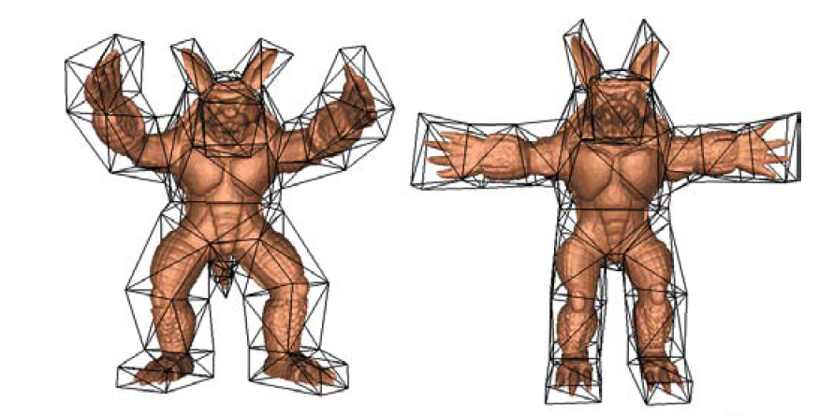
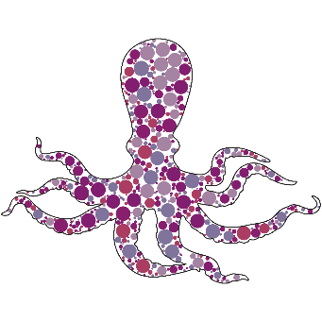
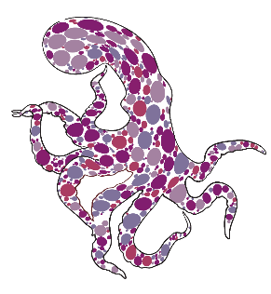
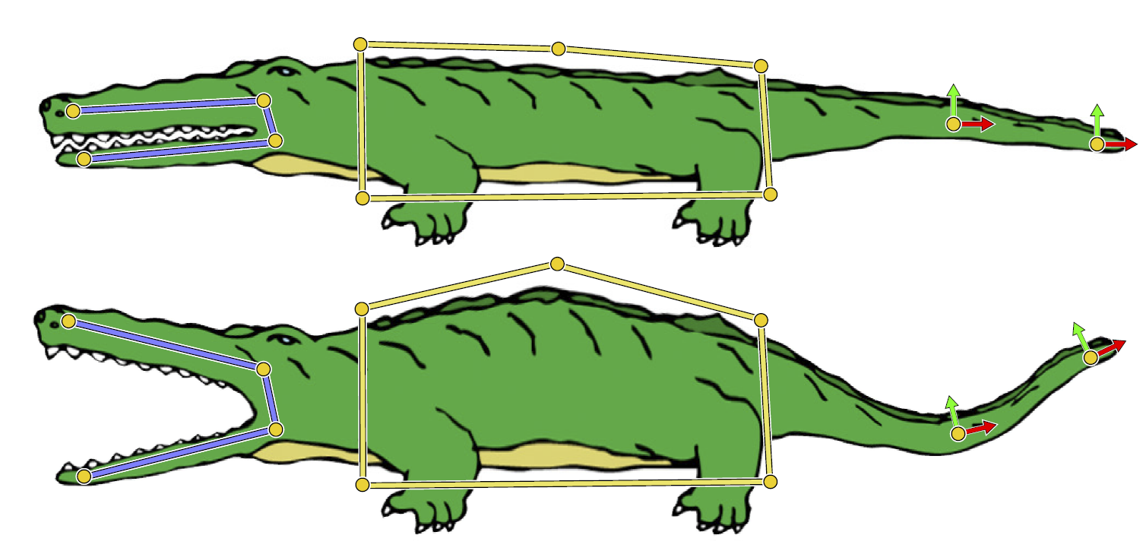
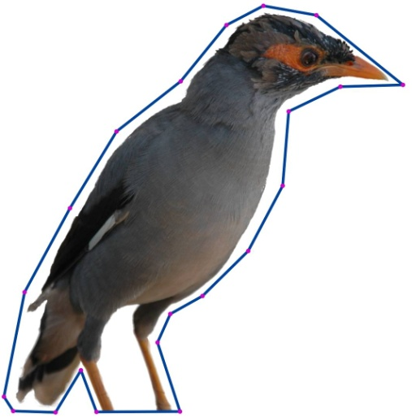
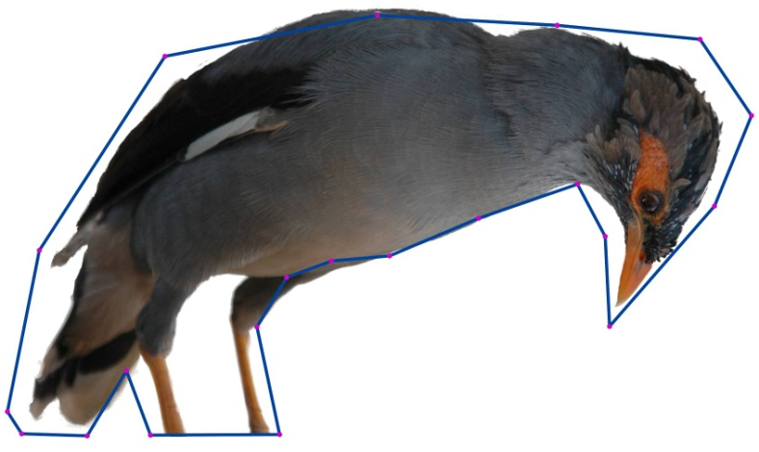
Mappings
Representation and Distortion
Modeling
[Sorkine & Alexa 07]
[Ju et al. 05]
[Poranne & Lipman 14]
[Jacobson 07]
[Weber et al. 09]
[Lipman et al. 07]

Slide 3
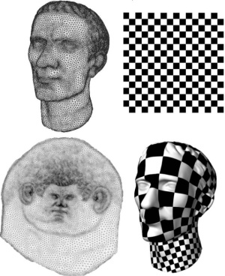
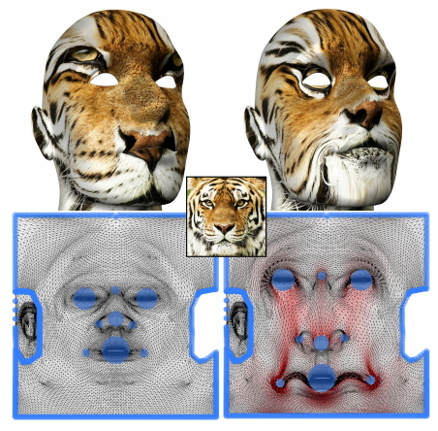
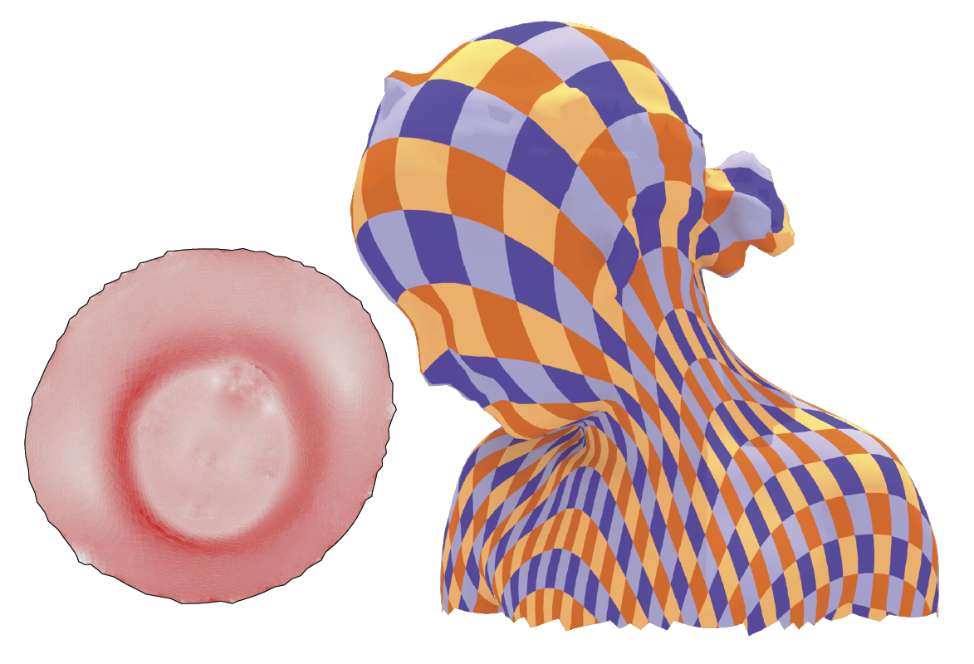
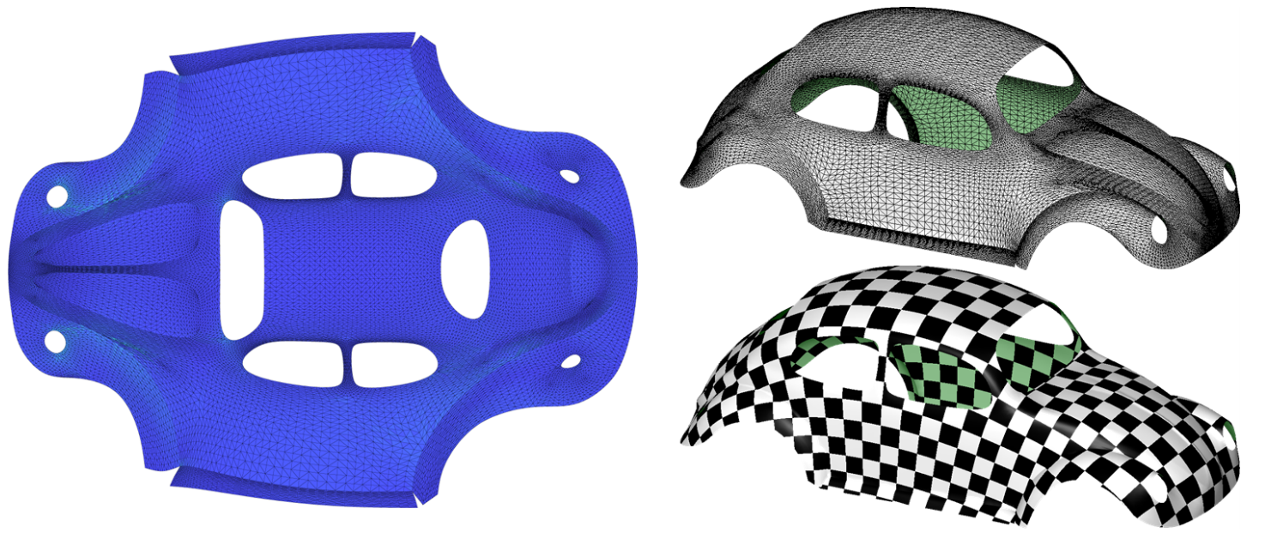
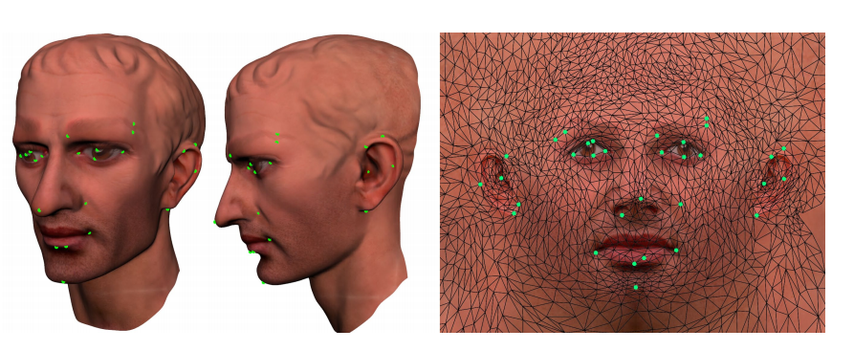
Mappings
Representation and Distortion
Parameterization
[Lévy et al. 02]
[Schuler et al. 13]
[Fu et al. 15]
[Weber et al. 12]
[Mullen et al. 08]

Slide 4

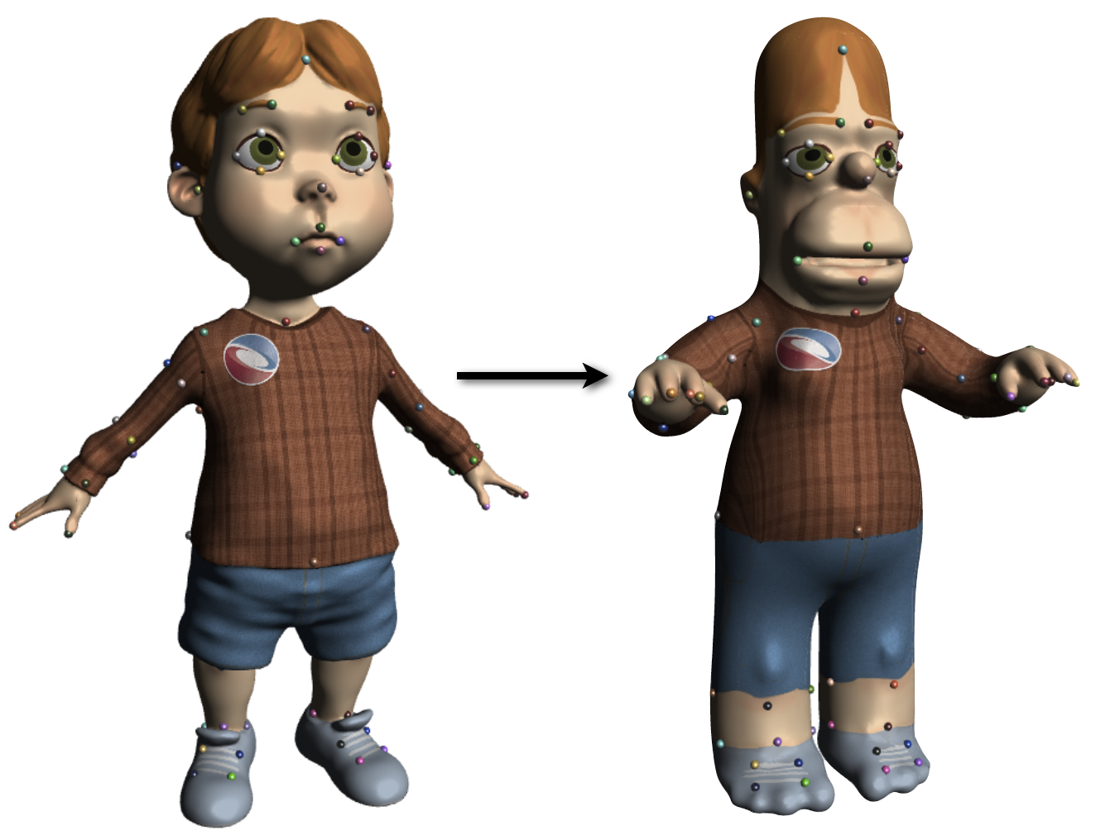
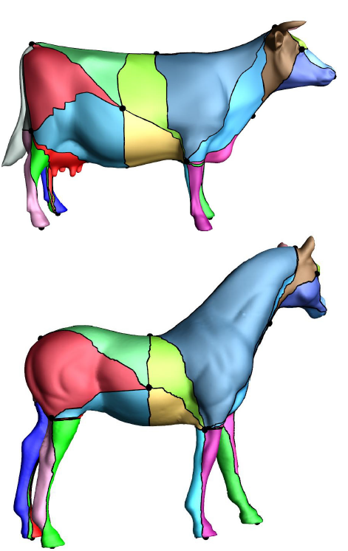
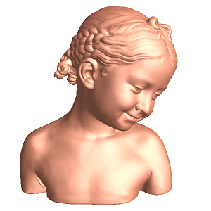

Mappings
Representation and Distortion
Surface mappings
[Kim et al. 11]
[Ovsjanikov et al. 12]
[Panozzo et al. 13]
[Kraevoy and Sheffer 04]
[Schreiner et al. 04]
[Jin et al. 08]

Slide 5
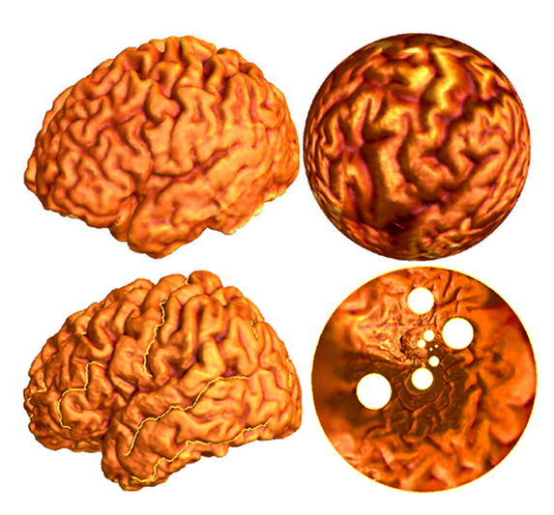
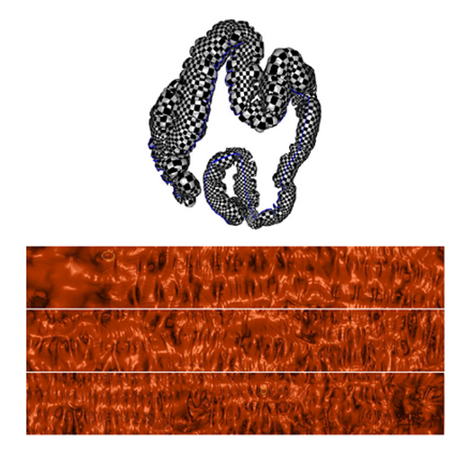
“Real” Applications
Brain/colon mapping
[Gu et al.]

Slide 6
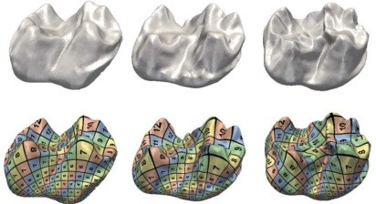
“Real” Applications
Biological Morphology
[Boyer et al. 2012]

Slide 7
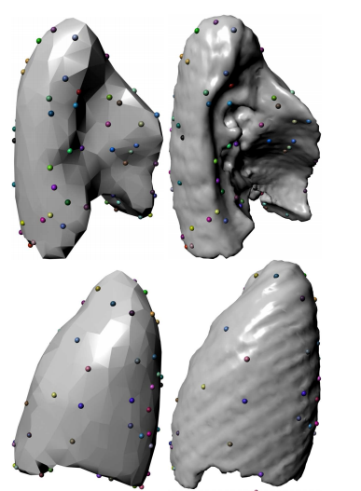
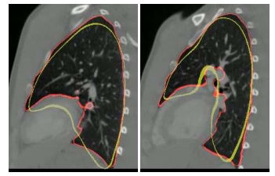
“Real” Applications
Medical segmentation/registration
[Levi and Gotsman 12]

Slide 8
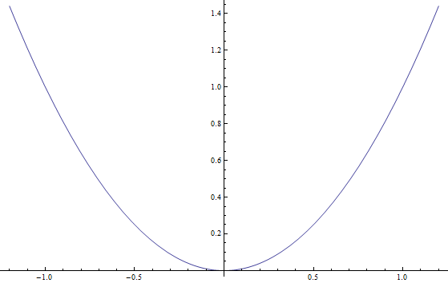


Definition
Mapping
/ Map :
A
smooth
function
between
shapes
/
spaces
Examples
$$f:ℝ→ℝ$$
$$f\left(x\right)=x^{2}$$

Slide 9
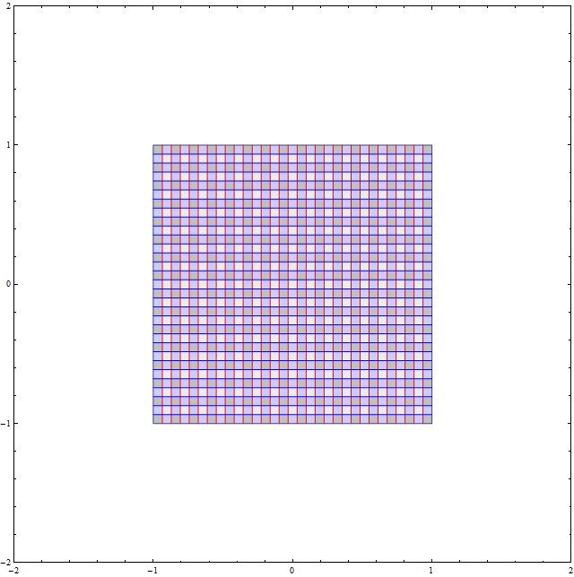
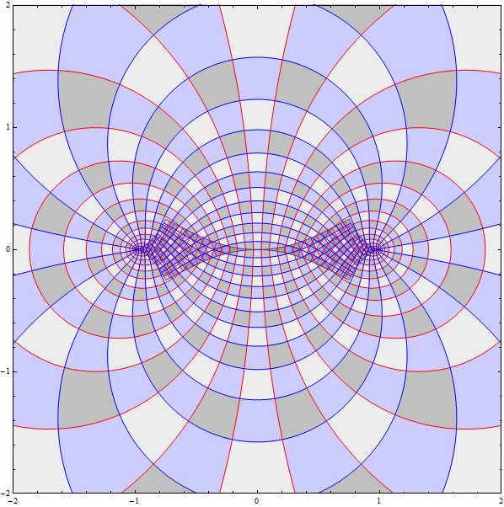
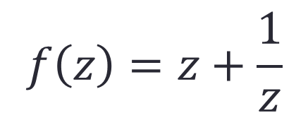

$$f\left(z\right)=z+\frac{1}{z}$$
$$f:ℝ^{2}→ℝ^{2}$$

Slide 10
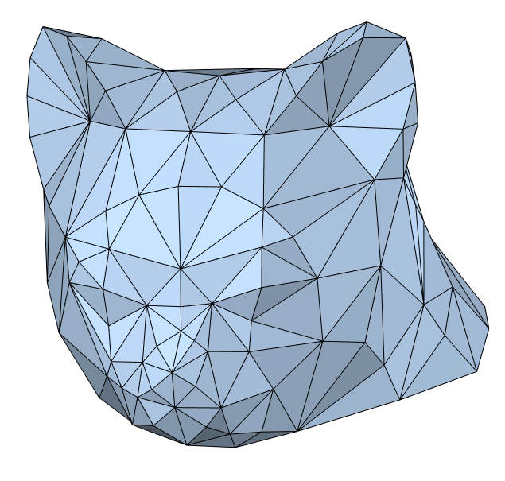
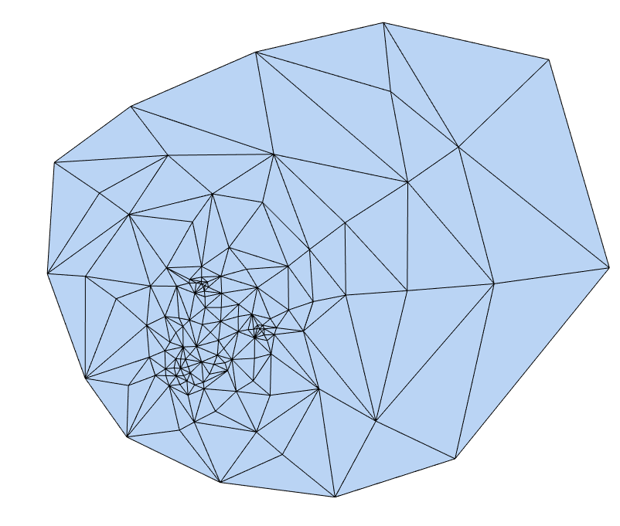

$$f:𝕄→ℝ^{2}$$

Slide 11
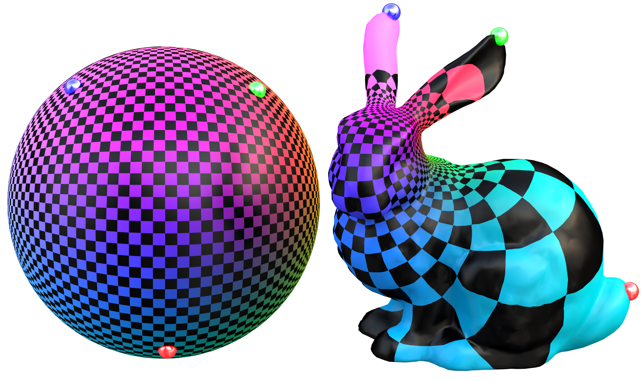

$$f:𝕄→𝕊^{2}$$
Notes:
We can also parameterize to other canonical domains like a sphere which you can see here

Slide 12
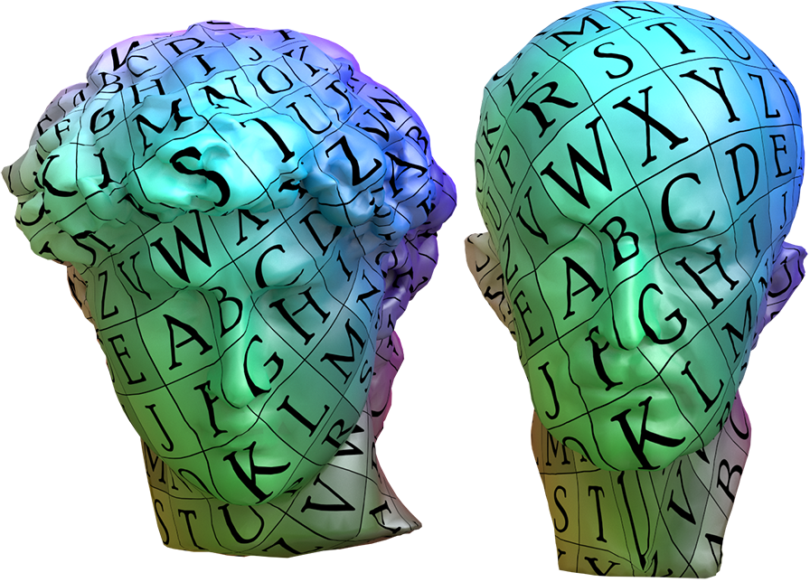

$$f:𝕄→𝕄^{′}$$

Slide 13

$$f:ℝ^{3}→ℝ^{3}$$

Slide 14
$$f:ℝ^{3}→ℝ^{3}$$
All
cases
are
based
on
the
same
concepts
and
use
similar
techniques
Our
focus
:
2D
mappings

Slide 15
Outline
Roi
  Representation
  Distortion of mappings
Shahar
  Optimization of mappings

Slide 16
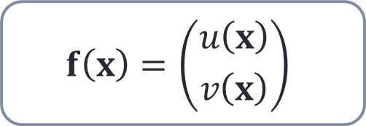
2D Maps : Representation
$$f\left(x\right)=\left({u\left(x\right) \atop v\left(x\right)}\right)$$

Slide 17
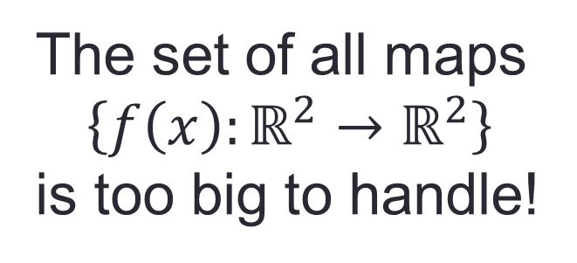
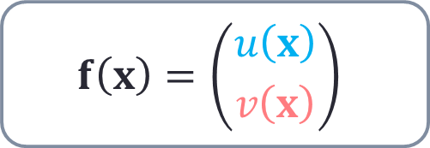

2D Maps : Representation
$$f\left(x\right)=\left({u\left(x\right) \atop v\left(x\right)}\right)$$
$$f$$
Solution: Represent maps as linear combination of basis functions
The set of all maps
$$\left\{f\left(x\right):ℝ^{2}→ℝ^{2}\right\}$$
is too big to handle!

Slide 18
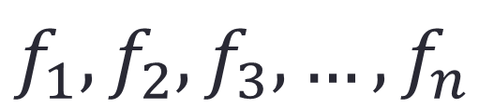
2D Maps : Representation
$$f_{1},f_{2},f_{3},…,f_{n}$$

Slide 19
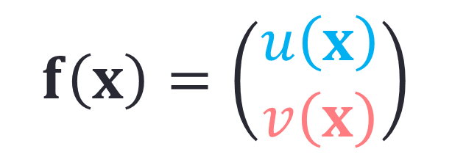
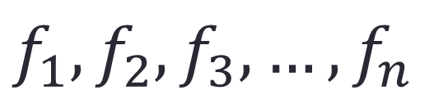
2D Maps : Representation
$$f_{1},f_{2},f_{3},…,f_{n}$$
$$f\left(x\right)=\left(\begin{aligned}u\left(x\right) \\ v\left(x\right)\end{aligned}\right)$$

Slide 20
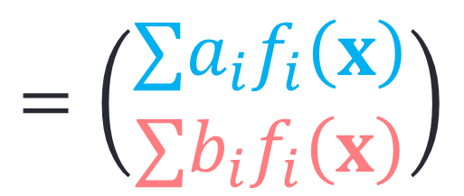
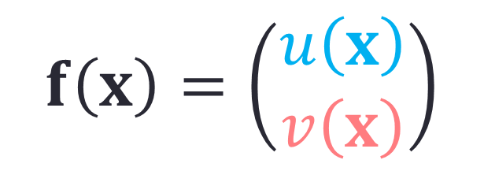
2D Maps : Representation
$$f_{1},f_{2},f_{3},…,f_{n}$$
$$f\left(x\right)=\left(\begin{aligned}u\left(x\right) \\ v\left(x\right)\end{aligned}\right)$$
$$=\left(\begin{aligned}∑a_{i}f_{i}\left(x\right) \\ ∑b_{i}f_{i}\left(x\right)\end{aligned}\right)$$

Slide 21



2D Maps : Representation
$$f_{1}\left(x,y\right)=x$$
$$f_{2}\left(x,y\right)=y$$
$$\left(x,y\right)⇒\left(2f_{1},f_{2}\right)$$

Slide 22

2D Maps : Representation
$$f_{1}\left(x,y\right)=x$$
$$f_{2}\left(x,y\right)=y$$
$$\left(x,y\right)⇒\left(f_{1}+f_{2},f_{2}\right)$$

Slide 23



2D Maps : Representation
$$f_{1}\left(x,y\right)=x$$
$$f_{2}\left(x,y\right) = y$$
$$f_{3}\left(x,y\right)$$
$$\left(x,y\right)⇒\left(f_{1}+f_{3},f_{2}+f_{3}\right)$$

Slide 24
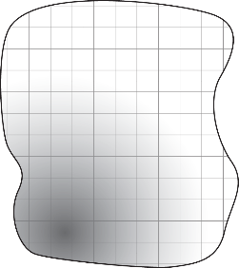
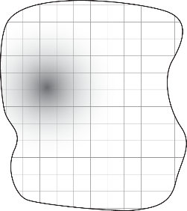
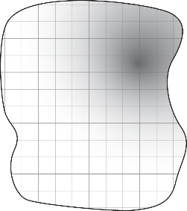
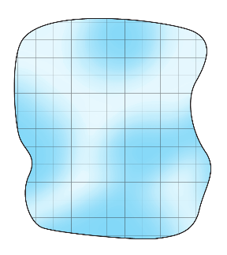





$$f_{1}$$
$$f_{2}$$
$$f_{n}$$
$$…$$
$$=$$

Slide 25






$$f_{1}$$
$$f_{2}$$
$$f_{n}$$
$$a_{1}$$
$$a_{2}$$
$$…$$
$$a_{n}$$
$$+$$
$$+$$
$$=$$

Slide 26
$$f_{1}$$
$$f_{2}$$
$$f_{n}$$
$$a_{1}$$
$$a_{2}$$
$$…$$
$$a_{n}$$
$$+$$
$$+$$
$$=$$

Slide 27
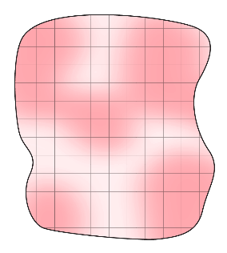









$$a_{1}$$
$$f_{1}$$
$$a_{2}$$
$$f_{2}$$
$$a_{n}$$
$$f_{n}$$
$$+$$
$$…$$
$$+$$
$$=$$
$$b_{1}$$
$$b_{2}$$
$$b_{n}$$

Slide 28
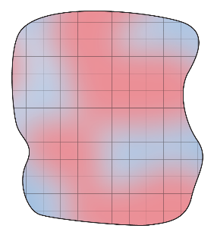



$$f_{1}$$
$$f_{2}$$
$$f_{n}$$
$$c_{1}$$
$$c_{2}$$
$$…$$
$$+$$
$$c_{n}$$
$$+$$
$$=$$

Slide 29

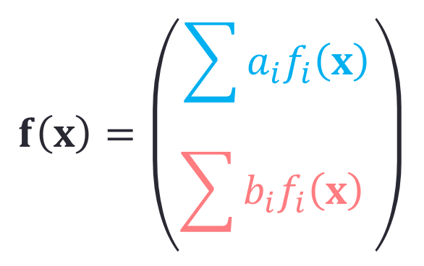


$$f\left(x\right)=\left(\begin{aligned}\sum{a_{i}f_{i}\left(x\right)} \\ \sum{b_{i}f_{i}\left(x\right)} \end{aligned}\right)$$
$$=\sum{c_{i}f_{i}\left(x\right)}$$
$$=$$

Slide 30

$$f\left(x\right)=\left(\begin{aligned}\sum{a_{i}f_{i}\left(x\right)} \\ \sum{b_{i}f_{i}\left(x\right)} \end{aligned}\right)$$
$$=\sum{c_{i}f_{i}\left(x\right)}$$
$$=$$

Slide 31

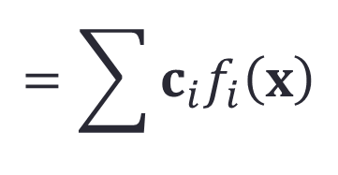


$$f\left(x\right)=\left(\begin{aligned}\sum{a_{i}f_{i}\left(x\right)} \\ \sum{b_{i}f_{i}\left(x\right)} \end{aligned}\right)$$
$$=\sum{c_{i}f_{i}\left(x\right)}$$
$$=$$
$$f\left(x\right)$$

Slide 32


Mappings for deformations
$$p_{i}$$

Slide 33

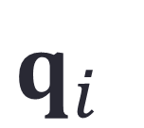
Mappings for deformations
$$q_{i}$$

Slide 34

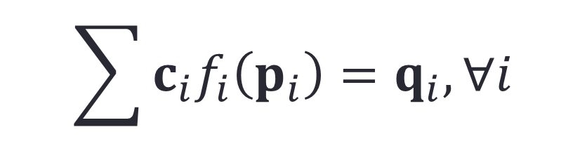

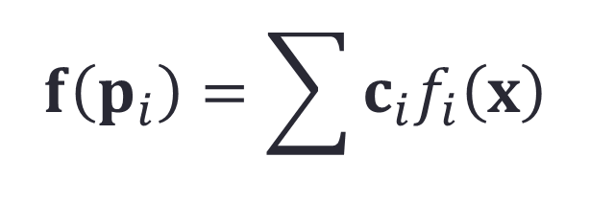
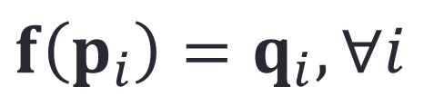

Deformation as an interpolation problem
$$f\left(p_{i}\right)=\sum{c_{i}f_{i}\left(x\right)}$$
$$q_{i}$$
$$c_{i}=?$$
$$p_{i}$$
$$f\left(p_{i}\right)=q_{i}, ∀i$$
$$\sum{c_{i}f_{i}\left(p_{i}\right)}=q_{i}, ∀i$$

Slide 35




Example: Thin Plate Spline
Solve the problem
$$\min{E_{\text{TPS}}(f)}=\iint{\left[{\left(\frac{∂^{2}f}{∂x^{2}}\right)}^{2}+2{\left(\frac{∂^{2}f}{∂x∂y}\right)}^{2}+{\left(\frac{∂^{2}f}{∂y^{2}}\right)}^{2}\right]}$$
Bending energy
$$\text{s}\text{.}\text{t}\text{.} f\left(p_{i}\right)=q_{i}, ∀i$$
General solution
$$f\left(p_{i}\right)=c_{0}+c_{x}x+c_{y}y+\sum{c_{i}ϕ\left(‖x−p_{i}‖\right)}$$
$$ϕ\left(r\right)=r^{2}\log{r}$$

Slide 36

Hermite interpolation
Interpolate derivatives

Slide 37
Hermite interpolation
Interpolate derivatives

Slide 38



Hermite interpolation
Interpolate derivatives
$$f\left(p_{i}\right)=q_{i}$$
$$Df\left(p_{i}\right)=D_{i}$$

Slide 39


Hermite interpolation
Interpolate derivatives
$$\sum{c_{i}f_{i}\left(p_{i}\right)}=q_{i}$$
$$\sum{c_{i}∇f_{i}\left(p_{i}\right)}=D_{i}$$

Slide 40



Example: Linear Blend Skinning
$$f\left(x\right)=\sum{w_{i}\left(x\right)\left(T_{i}x+q_{i}\right)}$$
Weights
Affine
transformations

Slide 41

Example: Linear Blend Skinning
$$f\left(x\right)=\sum{w_{i}\left(x\right)\left(T_{i}x+q_{i}\right)}$$

Slide 42




Example: Linear Blend Skinning
$$f\left(x\right)=\sum{w_{i}\left(x\right)\left(T_{i}x+q_{i}\right)}$$
Lagrange property
$$w_{i}\left(p_{j}\right)=δ_{ij}$$
Hermite (derivative) property
$$∇w_{i}\left(p_{j}\right)=0$$

Slide 43



Deformation as an boundary interpolation
$$f\left(x\right)$$
Target
Source

Slide 44







Example: Barycentric Coordinates
[Lipman et al]
[Li et al.]
[Schneider et al.]
[Weber et al.]
[Weber et. al]
[Li et al.]

Slide 45




Example: Barycentric Coordinates
$$α_{i}(x)$$
Stages:
Source shape
Polygonal cage
Coordinates
$$f\left(x\right)=\sum_{i=1}^{n}{α_{i}\left(x\right)q_{i}}$$

Slide 46
Example: Barycentric Coordinates
$$α_{i}(x)$$
Stages:
Source shape
Polygonal cage
Coordinates
$$f\left(x\right)=\sum_{i=1}^{n}{α_{i}\left(x\right)q_{i}}$$

Slide 47


Example: Barycentric Coordinates
$$q_{i}$$
$$α_{i}(x)$$
Stages:
Source shape
Polygonal cage
Coordinates
Manipulate cage
Apply deformation
$$f\left(x\right)=\sum_{i=1}^{n}{α_{i}\left(x\right)q_{i}}$$

Slide 48




Mean-value coordinates
Cauchy coordinates
Harmonic coordinates

Slide 49



Example: Hermite Bary’ Coordinates
$$f_{i}$$
$$f\left(x\right)=\sum_{i=1}^{n}{α_{i}\left(x\right)f_{i}}$$

Slide 50

Example: Hermite Bary’ Coordinates
$$f_{i}$$
$$f\left(x\right)=\sum_{i=1}^{n}{α_{i}\left(x\right)f_{i}}$$

Slide 51



$$f_{i}$$
$$f_{i}$$
$$f\left(x\right)=\sum_{i=1}^{n}{α_{i}\left(x\right)f_{i}}$$
$$d_{i}$$
$$+\sum_{i=1}^{n}{β_{i}\left(x\right)d_{i}}$$

Slide 52


Slide 54
Basis functions

Slide 55


What are good maps?
Local
Bijectivity
Low distortion
Not
Bijective
Lower
distortion
Bijective

Slide 56


Globally Bijective VS. Locally Bijective
Globally
Bijective
Locally
Bijective
$f$ is bijective
$f:U→f(U)$ is bijective

Slide 57

Globally Bijective VS. Locally Bijective
Globally
Bijective
Locally
Bijective
$f$ is bijective
$f:U→f(U)$ is bijective

Slide 58

Globally Bijective VS. Locally Bijective
Globally
Bijective
Locally
Bijective
$f$ is bijective
$f:U→f(U)$ is bijective

Slide 59

Globally Bijective VS. Locally Bijective
Globally
Bijective
Locally
Bijective
$f$ is bijective
$f:U→f(U)$ is bijective

Slide 60

Globally Bijective VS. Locally Bijective
Globally
Bijective
Locally
Bijective
$f$ is bijective
$f:U→f(U)$ is bijective

Slide 61

Globally Bijective VS. Locally Bijective
Globally
Bijective
Locally
Bijective
$f$ is bijective
$f:U→f(U)$ is bijective

Slide 62

Globally Bijective VS. Locally Bijective
Globally
Bijective
Locally
Bijective
$f$ is bijective
$f:U→f(U)$ is bijective
Still Bijective!

Slide 63

Globally Bijective VS. Locally Bijective
Globally
Bijective
Locally
Bijective
$f$ is bijective
$f:U→f(U)$ is bijective

Slide 64

Globally Bijective VS. Locally Bijective
Globally
Bijective
Locally
Bijective
$f$ is bijective
$f:U→f(U)$ is bijective

Slide 65

Globally Bijective VS. Locally Bijective
Globally
Bijective
Locally
Bijective
$f$ is bijective
$f:U→f(U)$ is bijective

Slide 66

Globally Bijective VS. Locally Bijective
Globally
Bijective
Locally
Bijective
$f$ is bijective
$f:U→f(U)$ is bijective
Not
Bijective!

Slide 67
Globally Bijective VS. Locally Bijective
Two
Pre-images
Not
Bijective!

Slide 68
Globally Bijective VS. Locally Bijective
Not
Bijective!
Notes:
And the other is there.

Slide 69


Globally Bijective VS. Locally Bijective
$$U$$
Only Locally
Bijective!
$f(U)$
Notes:
This map is however locally bijective. We know this is true because every neighborhood we look at, for example this one, is bijectivly mapped to its image. Of course, if we want to prove this using the definition we will have to work harder, but there actually a simpler sufficient condition, which I’ll show in a minute

Slide 70

Locally Bijection – Non-example
Notes:
Ok, now not all mappings are locally bijective. Here’s a non-example. Let start with this square and begin deforming it.

Slide 71

Locally Bijection – Non-example

Slide 72

Locally Bijection – Non-example

Slide 73

Locally Bijection – Non-example

Slide 74

Locally Bijection – Non-example
Notes:
Ok so far so good

Slide 75

Locally Bijection – Non-example

Slide 76

Locally Bijection – Non-example

Slide 77

Locally Bijection – Non-example

Slide 78

Locally Bijection – Non-example

Slide 79


Locally Bijection – Sufficient condition
$$f\left(x\right)=\left({u\left(x\right) \atop v\left(x\right)}\right)$$
$$f$$
The Jacobian:
$$𝒥f\left(x\right)=\left({∂_{x}u\left(x\right) \atop ∂_{x}v\left(x\right)} {∂_{y}u\left(x\right) \atop ∂_{y}v\left(x\right)}\right)$$

Slide 80


Locally Bijection – Sufficient condition
$$f\left(x\right)=\left({u\left(x\right) \atop v\left(x\right)}\right)$$
$$f$$
The Jacobian:
$$𝒥f\left(x\right)=\left({∂_{x}u\left(x\right) \atop ∂_{x}v\left(x\right)} {∂_{y}u\left(x\right) \atop ∂_{y}v\left(x\right)}\right)=\left({∇u\left(x\right) \atop ∇v\left(x\right)}\right)$$
The Condition:
$$\det{𝒥f\left(x\right)}>0, ∀x$$

Slide 81
Globally Bijective VS. Locally Bijective
Globally
Bijective
Locally
Bijective
$f$ is bijective
$f:U→f(U)$ is bijective

Slide 82

Globally Bijective VS. Locally Bijective
Globally
Bijective
Locally
Bijective
$f$ is bijective
$f:U→f(U)$ is bijective

Slide 83
Globally Bijective VS. Locally Bijective
Globally
Bijective
Locally
Bijective
$f$ is bijective
$f:U→f(U)$ is bijective
Google: “Global inversion theorems”

Slide 84
What are good maps?
Local
Bijectivity
Low distortion
Not
Bijective
Lower
distortion
Bijective

Slide 85


Distortion - Types
Conformal distortion
Isometric distortion

Slide 86
Distortion - Types
Conformal distortion
Isometric distortion
The distortion is a function
of the Jacobian at a point

Slide 87








Distortion - LSCM
[Lévy et al. 2002]
LSCM – Least Squares Conformal Map
We
want
the
to
be
a
Jacobian
similarity
matrix
$$\left({∂_{x}u \atop ∂_{x}v} {∂_{y}u \atop ∂_{y}v}\right)$$
$$\left({α \atop β} {−β \atop α}\right)$$
$$∂_{x}u$$
$$=$$
$$∂_{y}v$$
Cauchy-Riemann
Equations
$$∂_{y}u$$
$$=$$
$$−∂_{x}v$$

Slide 88










Distortion - LSCM
LSCM – Least Squares Conformal Map
We
want
the
to
be
a
Jacobian
similarity
matrix
$$\left({∂_{x}u \atop ∂_{x}v} {∂_{y}u \atop ∂_{y}v}\right)$$
$$\left({α \atop β} {−β \atop α}\right)$$
$$𝒟_{\text{LSCM}}=$$
$$∂_{x}u$$
$$∂_{y}v$$
$$+$$
$${\left( \right)}^{2}$$
$${\left( \right)}^{2}$$
$$−$$
$$+$$
$$∂_{y}u$$
$$∂_{x}v$$

Slide 89











Quick Notation Change
$$𝒥f$$
$$A$$
$$\left({∂_{x}u \atop ∂_{x}v} {∂_{y}u \atop ∂_{y}v}\right)$$
$$\left({a \atop c} {b \atop d}\right)$$
$$𝒟_{\text{LSCM}}=$$
$$∂_{x}u$$
$$∂_{y}v$$
$$+$$
$${\left( \right)}^{2}$$
$${\left( \right)}^{2}$$
$$−$$
$$+$$
$$∂_{y}u$$
$$∂_{x}v$$
$$a$$
$$d$$
$$+$$
$${\left( \right)}^{2}$$
$${\left( \right)}^{2}$$
$$−$$
$$+$$
$$b$$
$$c$$

Slide 90


Distortion – ASAP
[Liu et al. 2008]
ASAP– As Similar As Possible
$$𝒟_{\text{ASAP}}=$$
$${\left\|A−𝒮_{A}\right\|}_{F}^{2}$$
Jacobian
Closest
Similarity
How to compute closest similarity?

Slide 91
Distortion – ASAP
ASAP– As Similar As Possible
How to compute closest similarity?

Slide 92



Distortion – ASAP
ASAP– As Similar As Possible
How to compute closest similarity?
In 2D:
$$\min_{𝒮}{{\left\|A−𝒮\right\|}_{F}^{2}}$$
$$\text{s}\text{.}\text{t}\text{.} 𝒮 \text{is} \text{similarity}$$
$$\min_{α,β}{{\left\|\left({a \atop c} {b \atop d}\right) −\left({α \atop β} {−β \atop α}\right)\right\|}_{F}^{2}}$$

Slide 93


Distortion – ASAP
ASAP– As Similar As Possible
How to compute closest similarity?
In 2D:
$$\min_{𝒮}{{\left\|A−𝒮\right\|}_{F}^{2}}$$
$$\text{s}\text{.}\text{t}\text{.} 𝒮 \text{is} \text{similarity}$$
$$\frac{1}{2}\left(\begin{matrix}a+d & c−b \\ b−c & a+d\end{matrix}\right)$$
$$𝒮=$$

Slide 94




Distortion – ASAP
ASAP– As Similar As Possible
How to compute closest similarity?
In 2D:
$$\frac{1}{2}\left(\begin{matrix}a+d & c−b \\ b−c & a+d\end{matrix}\right)$$
$$\frac{1}{2}\left(\begin{matrix}a−d & c+b \\ b+c & d−a\end{matrix}\right)$$
$$A=$$
$$+$$

Slide 95


Distortion – ASAP
ASAP– As Similar As Possible
How to compute closest similarity?
In 2D:
$$𝒮_{A}$$
$$𝒮_{A}^{⊥}$$
$$\frac{1}{2}\left(\begin{matrix}a+d & c−b \\ b−c & a+d\end{matrix}\right)$$
$$\frac{1}{2}\left(\begin{matrix}a−d & c+b \\ b+c & d−a\end{matrix}\right)$$
$$A=$$
$$+$$
Similarity
Anti-Similarity

Slide 96



Distortion – ASAP
ASAP– As Similar As Possible
$$𝒮_{A}^{⊥}$$
$${\left\|A−𝒮_{A}\right\|}_{F}^{2}$$
Measure of antisimilarity
Jacobian
Closest
Similarity
$${\left\|\left(\begin{matrix}a−d & c+b \\ b+c & d−a\end{matrix}\right)\right\|}_{F}^{2}$$
$${\left(a−d\right)}^{2}+{\left(b+c\right)}^{2}$$

Slide 97
Distortion – ASAP
ASAP– As Similar As Possible
$$𝒮_{A}^{⊥}$$
$${\left\|A−𝒮_{A}\right\|}_{F}^{2}$$
LSCM = ASAP
Measure of antisimilarity
Jacobian
Closest
Similarity
$${\left\|\left(\begin{matrix}a−d & c+b \\ b+c & d−a\end{matrix}\right)\right\|}_{F}^{2}$$

Slide 98


Distortion - ARAP
ARAP– As Rigid As Possible
$$𝒟_{\text{ARAP}}=$$
$${\left\|A−ℛ_{A}\right\|}_{F}^{2}$$
Jacobian
Closest
Rotation
How to compute closest Rotation?

Slide 99







Singular Value Decomposition
Every Matrix $M$ has a factorization of the form
$$M$$
$$=$$
$$U$$
$$S$$
$$V^{T}$$
$$\left(\begin{matrix}σ_{1} & 0 \\ 0 & σ_{2}\end{matrix}\right)$$
$$σ_{1}>σ_{2}$$

Slide 100

Singular Value Decomposition
Every Matrix $M$ has a factorization of the form
$$M$$
$$=$$
$$U$$
$$S$$
$$V^{T}$$

Slide 101


Singular Value Decomposition
Every Matrix $M$ has a factorization of the form
$$M$$
$$=$$
$$U$$
$$S$$
$$V^{T}$$

Slide 102

Singular Value Decomposition
Every Matrix $M$ has a factorization of the form
$$M$$
$$=$$
$$U$$
$$S$$
$$V^{T}$$

Slide 103

Singular Value Decomposition
Every Matrix $M$ has a factorization of the form
$$M$$
$$=$$
$$U$$
$$S$$
$$V^{T}$$

Slide 104

Singular Value Decomposition
Every Matrix $M$ has a factorization of the form
$$M$$
$$=$$
$$U$$
$$S$$
$$V^{T}$$
$U$ and $V$ are not rotations!

Slide 105


Singular Value Decomposition
Every Matrix $M$ has a factorization of the form
$$M$$
$$=$$
$$U$$
$$S$$
$$R$$
$$V^{T}$$
$$\left(\begin{matrix}1 & 0 \\ 0 & −1\end{matrix}\right)$$

Slide 106


Singular Value Decomposition
Every Matrix $M$ has a factorization of the form
$$M$$
$$=$$
$$U$$
$$S$$
$$R$$
$$V^{T}$$

Slide 107

Singular Value Decomposition
Every Matrix $M$ has a factorization of the form
$$M$$
$$=$$
$$U$$
$$S$$
$$R$$
$$V^{T}$$

Slide 108

Singular Value Decomposition
Every Matrix $M$ has a factorization of the form
$$M$$
$$=$$
$$U$$
$$S$$
$$R$$
$$V^{T}$$

Slide 109

Singular Value Decomposition
Every Matrix $M$ has a factorization of the form
$$M$$
$$=$$
$$U$$
$$S$$
$$R$$
$$V^{T}$$

Slide 110
Signed Singular Value Decomposition
Every Matrix $M$ has a factorization of the form
$$M$$
$$=$$
$$U$$
$$S$$
$$R$$
$$V^{T}$$

Slide 111



Signed Singular Value Decomposition
Every Matrix $M$ has a factorization of the form
$$M$$
$$=$$
$$U$$
$$R$$
$$S$$
$$V^{T}$$
$$\left(\begin{matrix}σ_{1} & 0 \\ 0 & −σ_{2}\end{matrix}\right)$$
$$σ_{1}>σ_{2}$$
Now $U$ and $V$ are rotations!

Slide 112


Signed Singular Value Decomposition
Every Matrix $M$ has a factorization of the form
$$M$$
$$=$$
$$U$$
$$R$$
$$S$$
$$V^{T}$$
$$\left(\begin{matrix}σ_{1} & 0 \\ 0 & −σ_{2}\end{matrix}\right)$$
$$σ_{1}>σ_{2}$$
Now $U$ and $V$ are rotations!
What if $U$ and $V$ both had reflections?

Slide 113



Signed Singular Value Decomposition
Every Matrix $M$ has a factorization of the form
$$M$$
$$=$$
$$U$$
$$R$$
$$S$$
$$V^{T}$$
$$\left(\begin{matrix}σ_{1} & 0 \\ 0 & −σ_{2}\end{matrix}\right)$$
$$σ_{1}>σ_{2}$$
Now $U$ and $V$ are rotations!
What if $U$ and $V$ both had reflections?
$$\text{sign}\det{M}=\text{sign}\left(σ_{2}\right)$$

Slide 114







Singular values in 2D
Closed form expression
$$𝒥f=\left({∂_{x}u \atop ∂_{x}v} {∂_{y}u \atop ∂_{y}v}\right)=\left({∇u \atop ∇v}\right)$$
$$∇$$
$$∇$$
$$α=\frac{∇u+ v}{2}$$
$$β=\frac{∇u+ v}{2}$$
$$σ_{1}=\left\|α\right\|+\left\|β\right\|$$
$$σ_{2}=\left\|α\right\|−\left\|β\right\|$$

Slide 115
Distortion - ARAP
ARAP– As Rigid As Possible
$$𝒟_{\text{ARAP}}=$$
$${\left\|A−ℛ_{A}\right\|}_{F}^{2}$$
Jacobian
Closest
Rotation
How to compute closest Rotation?

Slide 116


Distortion - ARAP
ARAP– As Rigid As Possible
$$𝒟_{\text{ARAP}}=$$
$${\left\|A−ℛ_{A}\right\|}_{F}^{2}$$
Jacobian
Closest
Rotation
$$A=USV^{T}$$
$$ℛ_{A}=UV^{T}$$
Proof: Using Lagrange multipliers

Slide 117


Distortion – ASAP
ASAP– As Similar As Possible
$$𝒟_{\text{ASAP}}=$$
$${\left\|A−𝒮_{A}\right\|}_{F}^{2}$$
Jacobian
Closest
Similarity
$$A=USV^{T}$$
$$𝒮_{A}=\overline{σ}UV^{T}$$
$$\overline{σ}=\frac{σ_{1}+σ_{2}}{2}$$

Slide 118
Distortion - ARAP
ARAP– As Rigid As Possible
$$𝒟_{\text{ARAP}}=$$
$${\left\|A−ℛ_{A}\right\|}_{F}^{2}$$
Jacobian
Closest
Rotation
$$A=USV^{T}$$
$$ℛ_{A}=UV^{T}$$
Proof: Using Lagrange multipliers

Slide 119





Distortion - ARAP
ARAP– As Rigid As Possible
$$𝒟_{\text{ARAP}}=$$
$${\left\|A−ℛ_{A}\right\|}_{F}^{2}$$
$${=\left\|A−UV^{T}\right\|}_{F}^{2}$$
$${=\left\|USV^{T}−UV^{T}\right\|}_{F}^{2}$$
$${=\left\|U(S−I)V^{T}\right\|}_{F}^{2}$$
$${=\left\|(S−I) \right\|}_{F}^{2}$$
$$={\left(σ_{1}−1\right)}^{2}+{\left(σ_{2}−1\right)}^{2}$$

Slide 120





Distortion - ASAP
ASAP– As Similar As Possible
$$𝒟_{\text{ASAP}}=$$
$${\left\|A−𝒮_{A}\right\|}_{F}^{2}$$
$${=\left\|USV^{T}−\overline{σ}UV^{T}\right\|}_{F}^{2}$$
$${=\left\|U(S−\overline{σ}I)V^{T}\right\|}_{F}^{2}$$
$$={\left(σ_{1}−\overline{σ}\right)}^{2}+{\left(σ_{2}−\overline{σ}\right)}^{2}$$
$$={\left(σ_{1}−σ_{2}\right)}^{2}$$

Slide 121





Distortion bias
$$𝒟_{\text{ASAP}}(A)$$
$$<$$
$$𝒟_{\text{ASAP}}(2A)$$
$${\left(σ_{1}−σ_{2}\right)}^{2}$$
$${\left(2σ_{1}−2σ_{2}\right)}^{2}$$

Slide 122

Conformal distortion
$$\frac{σ_{1}}{σ_{2}}$$

Slide 123







