Slide 1
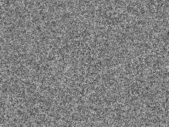
A Tour of
Image Denoising
Shahar Kovalsky
Alon Faktor
17/4/2011

Slide 2
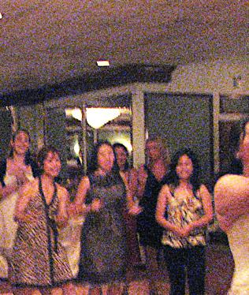
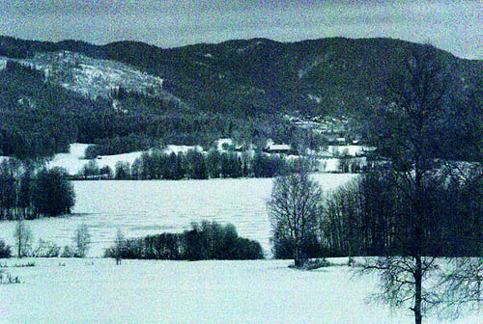
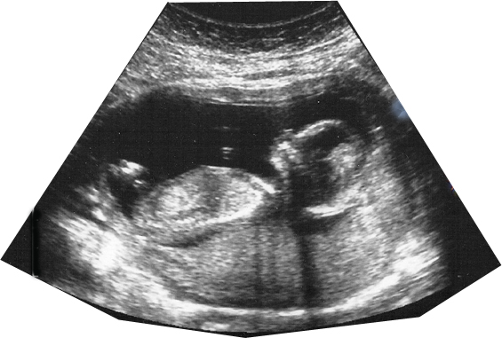
Indoor – low light
IR
US

Slide 3
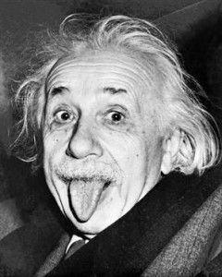
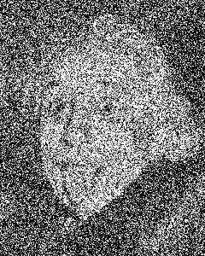
Can we (humans) denoise?

Slide 4
Indoor – low light
IR
US

Slide 5
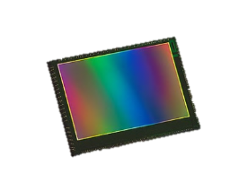
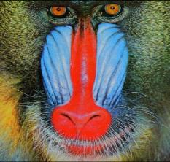
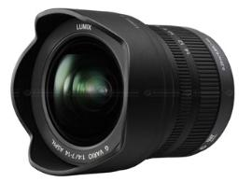
Sources of Noise
Additive Noise
(read+amplifier noise)
Multiplicative Noise
(shot noise)
01010101010101010101010101010101010101010101010101
Gain

Slide 6
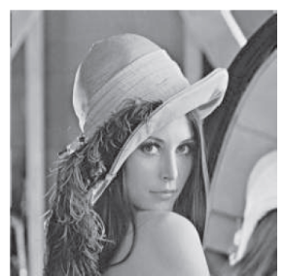
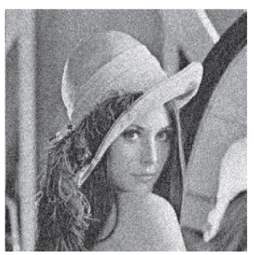
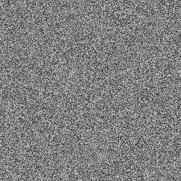
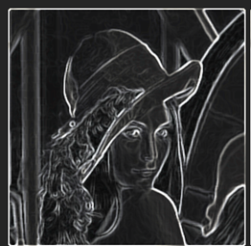


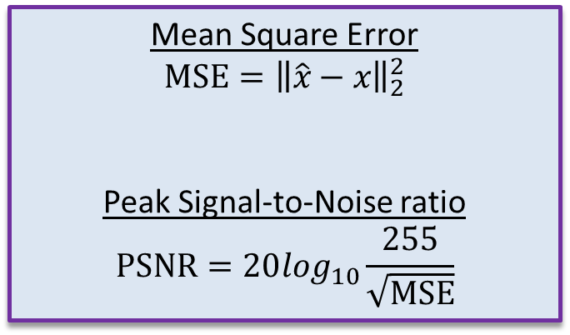



Problem Definition
Visual Quality
MSE / PSNR
$$x$$
$$\hat{x}$$
Mean Square Error
$$MSE={\left\|\hat{x}−x\right\|}_{2}^{2}$$
Peak Signal-to-Noise ratio
$$PSNR=20\log_{10}\frac{255}{\sqrt{MSE}}$$
$$y=x+n$$
$$n$$
$$\hat{n}=y−\hat{x}$$
Noise?

Slide 7
Problem Definition
Visual Quality
MSE / PSNR
$$x$$
$$\hat{x}$$
Mean Square Error
$$MSE={\left\|\hat{x}−x\right\|}_{2}^{2}$$
Peak Signal-to-Noise ratio
$$PSNR=20\log_{10}\frac{255}{\sqrt{MSE}}$$
$$y=x+n$$
$$n$$
$$\hat{n}=y−\hat{x}$$
Noise?

Slide 8
Outline
Classical Denoising
  Spatial Methods
  Transform Methods
State-of-the-art Methods
  GSM – Gaussian Scale Mixture
  NLM – Non-local means
  BM3D – Block Matching 3D collaborative filtering

Slide 9


Denoising in the Spatial Domain
The “classical” assumption:
Images are piecewise constant
Neighboring pixels are highly correlated
$⇒$Denoise = “Average nearby pixels” (filtering)

Slide 10
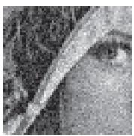
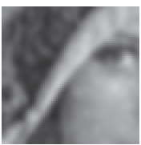
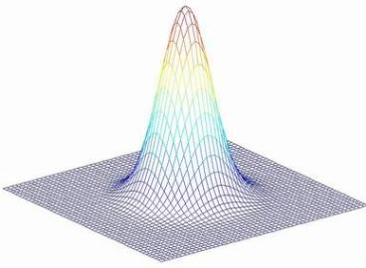

Gaussian Smoothing
*h
=
*
*h
*h
h
$$\hat{x}\left(i\right)=\frac{1}{C_{i}}\sum_{j}{y(j)e^{−\frac{{\left\|i−j\right\|}^{2}}{2σ_{}^{2}}}}$$

Slide 11
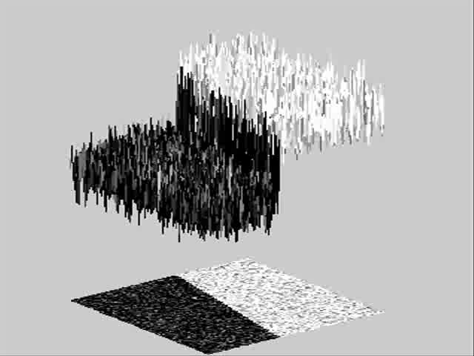
Toy Example
How can we preserve the fine details?

Slide 12
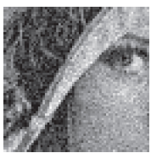
Local adaptive smoothing
Non uniform smoothing
Depending on image content:
  Smooth where possible
  Preserve fine details
How?
*h3
*h2
*h1

Slide 13
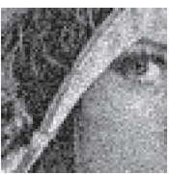
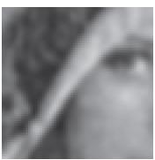
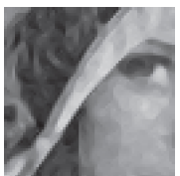
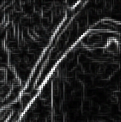

Anisotropic Filtering
Edges $⇒$ smooth only along edges
“Smooth” regions $⇒$ smooth isotropically
gradient
Perona and Malik (1990)

Slide 14
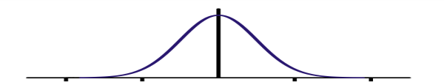
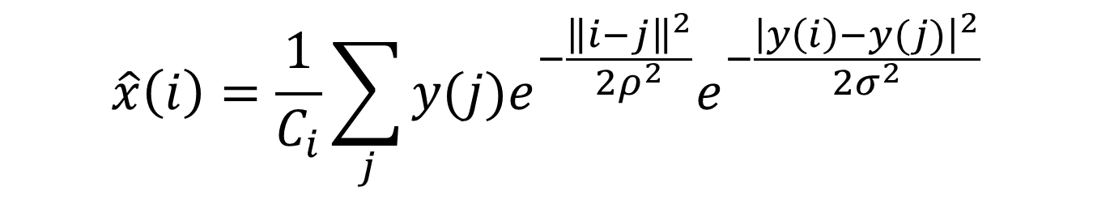


Bilateral Filtering
$$\hat{x}\left(i\right)=\frac{1}{C_{i}}\sum_{j}{y(j)e^{−\frac{{\left\|i−j\right\|}^{2}}{2ρ^{2}}}e^{−\frac{{\left|y\left(i\right)−y(j)\right|}^{2}}{2σ_{}^{2}}}}$$
Intensity
$$σ$$
$$ρ$$
Space
Smith and Brady (1997)

Slide 15


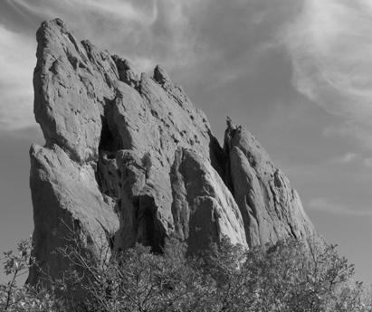
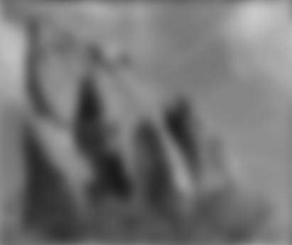


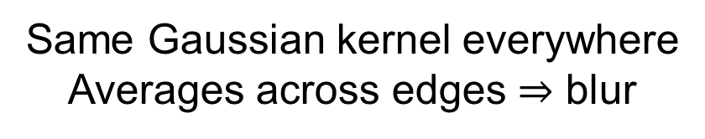
Gaussian Smoothing
Slides taken from Sylvain Paris, Siggraph 2007
*
input
output
*
*
Same Gaussian kernel everywhere
Averages across edges $⇒$ blur

Slide 16

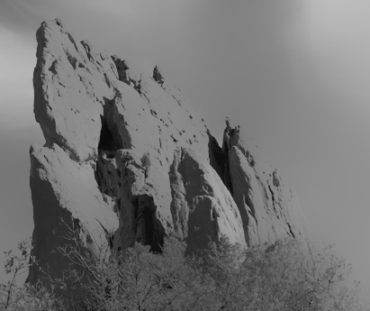


Bilateral Filtering
Slides taken from Sylvain Paris, Siggraph 2007
*
input
output
*
*
Kernel shape depends on image content
Avoids averaging across edges

Slide 17
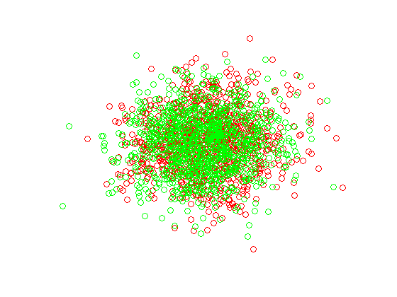
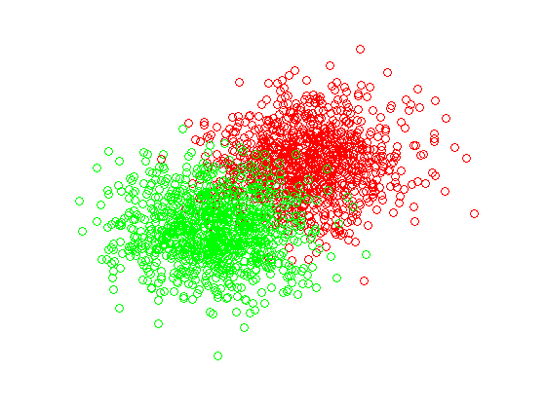
Denoising in the Transform Domain
Motivation – New representation where signal and noise are more separated
Denoise = “Suppress noise coefficients while preserving the signal coefficients”

Slide 18
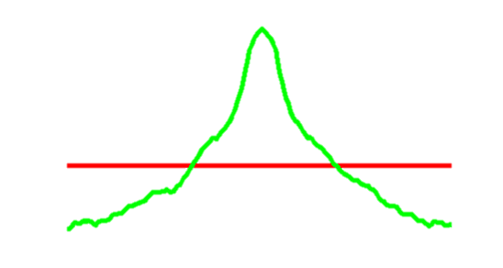


Fourier Domain
Noise
White $⇒$ spread uniformly in Fourier domain
Signal
Spread non-uniformly in the Fourier domain
signal
noise
$$ω$$

Slide 19
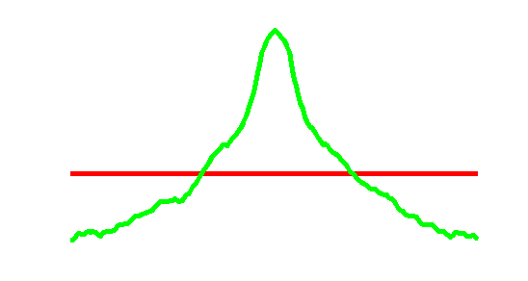
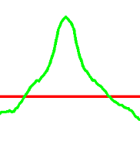


Low-Pass Filtering
Low pass with some cut-off frequency
Keeps most of the signal energy
Equivalent to Global Smoothing
$$×$$
1
$$=$$
Low pass filter

Slide 20


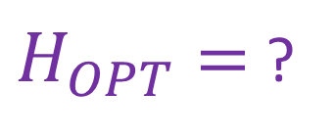


Looking for an Optimal Filter
$$\hat{X}\left(ω\right)=Y\left(ω\right)H\left(ω\right)$$
Assumption: Signal and Noise are
Stationary independent random processes
$$\hat{X} =$$
$$×$$
$$Y$$
$H_{OPT}=$ ?

Slide 21

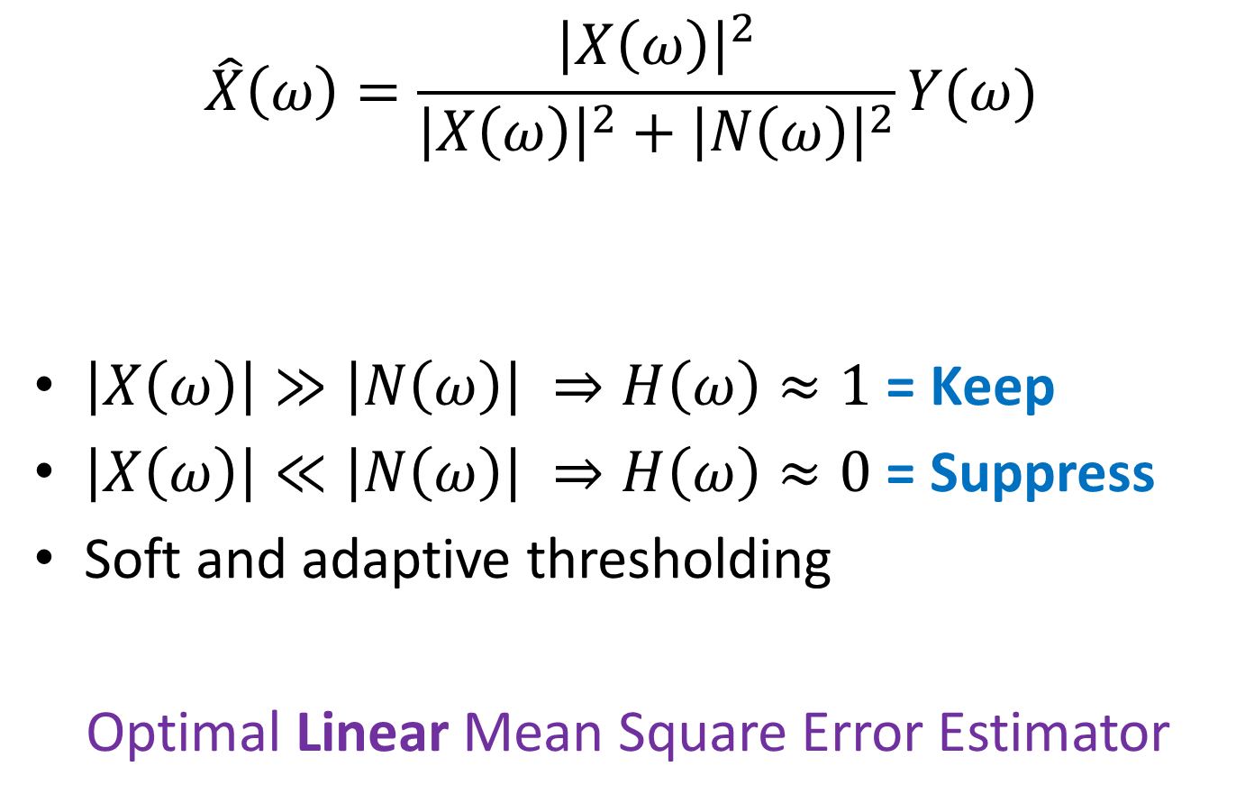
The Fourier Wiener Filter
$$\hat{X}\left(ω\right)=\frac{{\left|X\left(ω\right)\right|}^{2}}{{\left|X\left(ω\right)\right|}^{2}+{\left|N\left(ω\right)\right|}^{2}}Y(ω)$$
$\left|X\left(ω\right)\right|≫\left|N\left(ω\right)\right| ⇒H\left(ω\right)≈1$ = Keep
$\left|X\left(ω\right)\right|≪\left|N\left(ω\right)\right| ⇒H\left(ω\right)≈0$ = Suppress
Soft and adaptive thresholding
Optimal Linear Mean Square Error Estimator
$$H_{OPT}\left(ω\right)$$

Slide 22
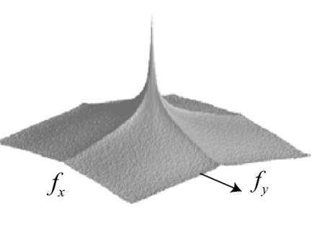
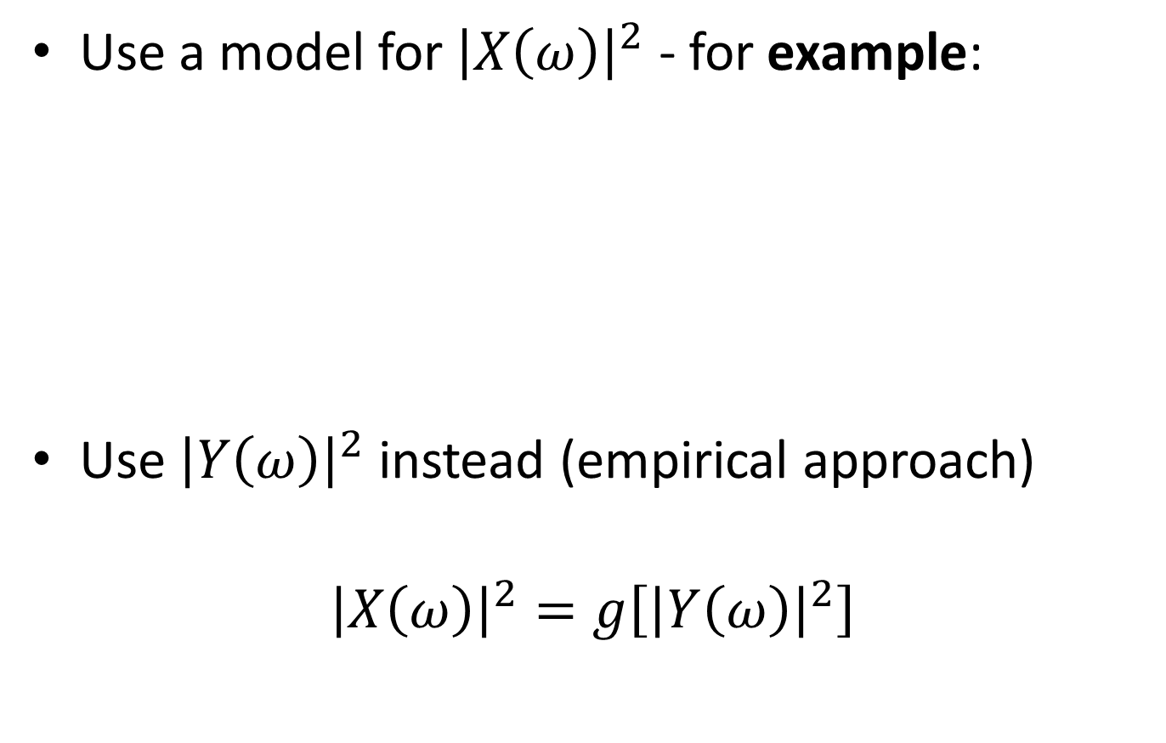
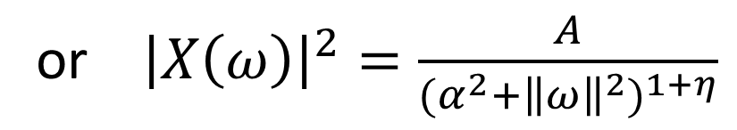
Fourier Wiener Filter in Practice
Use a model for${\left|X\left(ω\right)\right|}^{2}$ - for example:
Use${\left|Y\left(ω\right)\right|}^{2}$ instead (empirical approach)
$${\left|X\left(ω\right)\right|}^{2}=g\left[{\left|Y\left(ω\right)\right|}^{2}\right]$$
or ${\left|X\left(ω\right)\right|}^{2}=\frac{A}{(α^{2}+{{\left\|ω\right\|}^{2})}^{1+η}}$
Ramani et al. (2006)
“… the Stochastic Matern Model”

Slide 23
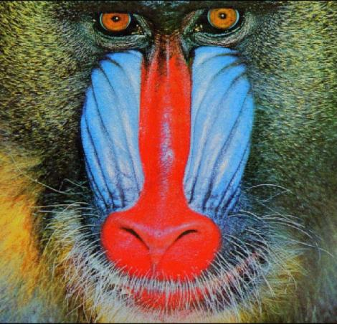
Why isn’t it enough?
We assumed stationarity:
“statistics of all image windows is the same”
But natural images are not stationary

Slide 24

Why isn’t it enough?
Mismatches and errors $⇒$ global artifacts

Slide 25

The Windowed Fourier Wiener Filter
Image has a local structure
$⇒$Denoise each region based on its own statistics
Perform Wiener filtering in image windows

Slide 26
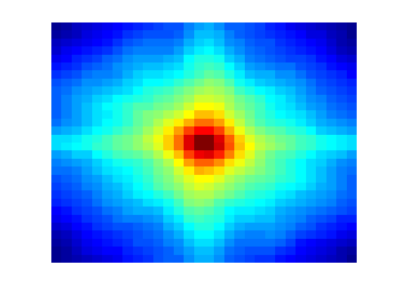
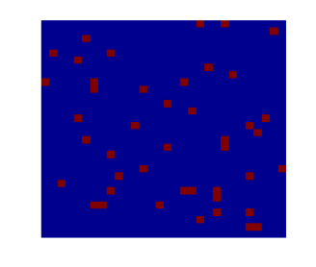
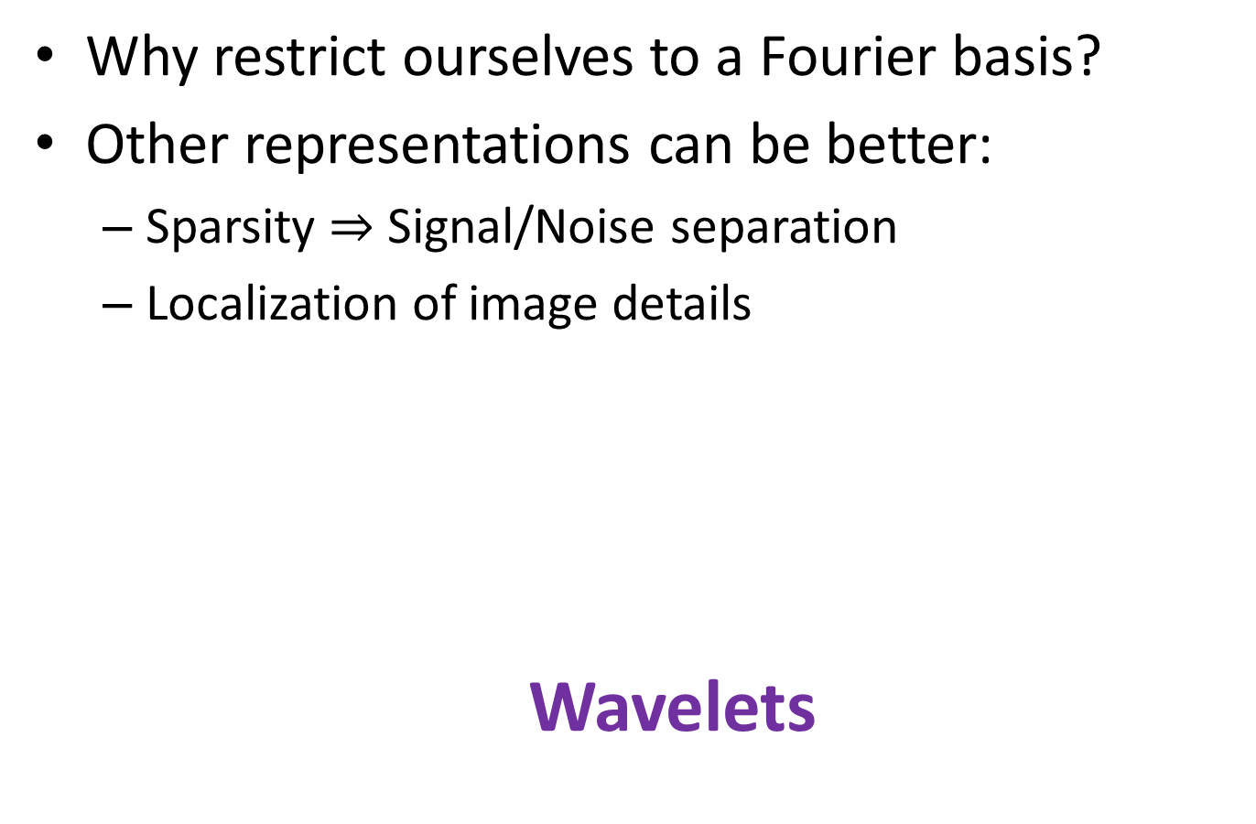
Can we do better?
Why restrict ourselves to a Fourier basis?
Other representations can be better:
  Sparsity $⇒$ Signal/Noise separation
  Localization of image details
  Wavelets

Slide 27
Fourier Decomposition
=
+
k(1)
+
k(2)
+
k(3)
···

Slide 28
Windowed Fourier Decomposition
=
+
+ ···
k(1,1)
k(1,2)
+
+ ···
k(2,1)
k(2,2)
+
+ ···
k(3,1)
k(3,2)
···
···

Slide 29
Wavelet Decomposition
mother wavelet
scaled & translated
versions
=
+ ···
k(1,1)
+
+ ···
k(2,1)
k(2,2)
+
+
+···
k(3,1)
k(3,2)
k(3,3)
···
···
···

Slide 30
Space-Frequency Localization
Windowed Fourier
Uniform tiling
Wavelets
Non-uniform tiling
frequency
f
coefficients
x
space
(time)
Better distribution of the “Coefficient Budget”

Slide 31






Discrete Wavelet Transform (DWT)
Signal
Recursively, split to
  Approximation
  Details
LPF
HPF
2$↓$
2$↓$
LPF
HPF
Details
Fine Coarse
2$↓$
2$↓$
LPF
HPF
Details
2$↓$
2$↓$
Approx
Details

Slide 32


Wavelet Transform - Example
Original image
1 level DWT

Slide 33
Wavelet Transform - Example
Original image
2 level DWT

Slide 34







Wavelet Pyramid
Low-pass residual
(approximation)
Sub-band
(detail)
scale
orientation

Slide 35


Wavelet Thresholding (WT)
Wavelet $⇒$ Sparser Representation
Improved separation between signal and noise at different scales and orientations
Thresholding (hard/soft) is more meaningful

Slide 36

A Probabilistic Perspective
Learn or assume statistical model of image and noise - $p\left(x\right), p\left(n\right)$
Use Bayesian inference to obtain $\hat{x}$

Slide 37


Which image do you prefer?

Slide 38

A Probabilistic Perspective
With some prior knowledge about images
Denoise = “find an optimal explanation”:
  MAP – Maximum a posterior
  $$\hat{x}={argmax}_{x}p\left(x | y\right)$$
  MMSE – Minimum Mean Square Error
  $$\hat{x}={argmin}_{\hat{x}}E\left\{{\left(\hat{x}\left(y\right)−x\right)}^{2}\right\}=E\left(x | y\right)$$

Slide 39






Performance Evaluation
Denoised Images
Original
$$σ=20$$
Gaussian
Smoothing
Anisotropic
Filtering
Bilateral Filtering
Windowed
Weiner
Hard WT
Soft WT
Buades et al. (2005)

Slide 40






Performance Evaluation
Method Noise
Gaussian
Smoothing
Anisotropic
Filtering
Bilateral Filtering
Windowed
Weiner
Hard WT
Soft WT
Buades et al. (2005)

Slide 41





Conclusions
 | Denoised Image | Method Noise
Spatial Methods
Transform Methods

Slide 42

Taking it up a notch...

Slide 43
State of the art Methods
BLS-GSM
BM3D
NLM
Spatial Methods
Transform Methods

Slide 44
BLS-GSM-Wavelet Denoising
Bayes Least Squares Gaussian Scale Mixture Wavelet Denoising
(Portilla et al. 2003)
Transform to Wavelet domain
Assume GSM model on neighborhoods
Denoise using BLS estimation

Slide 45










Over Complete Wavelets
BLS-GSM uses over-complete wavelets
Representation is redundant
$⇒$ Combined estimates may improve denoising
Classical (orthogonal) Wavelets:
#coefficients = #pixels
Over-complete Wavelets:
#coefficients > #pixels
…

Slide 46
Local Neighborhoods
Spatial-Scale Neighborhood
For example:
  Scale parent of central coef
  3x3 in space
Such neighborhoods are highly structured
x

Slide 47






The GSM model
$$P\left(z\right)\sim \frac{1}{z}$$
$$C_{U}$$
$$C_{N}$$
$$Y=\sqrt{Z}U+N$$
$$X$$
GSM
Gaussian

Slide 48


The GSM model
$${z_{0}C}_{U}+C_{N}$$
known
$$C_{U}$$
$$C_{N}$$
$$Y=\sqrt{Z}U+N$$
$$Y=\sqrt{z_{0}}U+N$$
Gaussian
Gaussian
Gaussian
Everything is Gaussian!

Slide 49

2-Step GSM Denoising
The Naive approach
For each neighborhood $Y$:
  Estimate $Z$ => $X,Y$ are jointly Gaussian
  Denoise= optimal estimation of $X|Y,Z=z_{0}$
  In MMSE sense:
  $$\hat{X}\left(Y\right)=E\left(X | Y,Z=z_{0}\right)={z_{0}C}_{U}{\left({z_{0}C}_{U}+C_{N}\right)}^{−1}Y$$
  This is the Wiener estimate of $X$

Slide 50

Joint GSM Denoising
2-Step is sub-optimal…
For each neighborhood $Y$:
Find the MMSE estimator -> $E\left(X | Y\right)$
  $$E\left(X | Y\right)=\int{p\left(z | Y\right)E\left(X | Y,z\right)dz}$$
?
The local Wiener estimate
(shown last slide)

Slide 51


Posterior distribution of multiplier
Bayes’ rule:
$$p\left(Z | Y\right)=\frac{p\left(Y | Z\right)p_{z}\left(Z\right) }{\int{p\left(Y | α\right)p_{z}\left(α\right)dα}}$$
Gaussian
(given $Z$)
Known
(Prior)

Slide 52



Weighted sum of Wiener estimates
$$\hat{X}=E\left(X | Y\right)=\int{p\left(z | Y\right)E\left(X | Y,z\right)dz}$$
$$\hat{X}=\int{w_{z}\left(Y\right)∙{\text{W}\text{iener}}_{z}\left(Y\right)dz}$$
Weighted sum of local Wiener estimates
All $z$-explanations contribute to the estimate!

Slide 53


BLS-GSM-Wavelet Denoising
Local neighborhood
“sophisticated” Wiener Filter
GSM
“Clean” Wavelet sub-bands
Decompose to
Wavelet
sub-bands
“sophisticated” Wiener Filter
Local neighborhood
GSM
.
.
.
Local neighborhood
“sophisticated” Wiener Filter
GSM

Slide 54
State of the art Methods
BLS-GSM
BM3D
NLM
Spatial Methods
Transform Methods

Slide 55

Motivation - Drawback of Locality
Previous methods perform some local filtering
$⇒$ mixing of pixels from different statistics
$⇒$ blur
Goal:
Reduce the mixing $⇔$ “smarter” localization

Slide 56



Motivation - Temporal perspective
Assume a static scene
Consider multiple images $y(t)$ at different times
The signal $x(t)$ remains constant
$n(t)$ varies over time with zero mean

Slide 57


“Temporal Denoising”
Average multiple images over time

Slide 58
“Temporal Denoising”
Average multiple images over time

Slide 59
“Temporal Denoising”
Average multiple images over time

Slide 60

Redundancy in natural images
Glasner et al. (2009)

Slide 61



Single image “time-like” denoising
Unfortunately, patches are not exactly the same
$⇒$ simple averaging just won’t work

Slide 62





Non Local Means (NLM)
Baudes et al. (2005)
Use a weighted average based on similarity
$$\hat{x}\left(i\right)=\frac{1}{C_{i}}\sum_{j}{y(j) e^{−\frac{GSSD\left(y\left(N_{i}\right)−y\left(N_{j}\right)\right)}{2σ^{2}}}}$$
$$w(p,q)$$
$$w(p,r)$$
$$w(p,s)$$
$$w\left(i,j\right)$$

Slide 63



From Bilateral Filter to NLM
$${\hat{x}\left(i\right)}_{BL}=\frac{1}{C_{i}}\sum_{j}{y(j){e^{−\frac{{\left|y\left(i\right)−y(j)\right|}^{2}}{2σ_{}^{2}}}e}^{−\frac{{\left\|i−j\right\|}^{2}}{2ρ^{2}}}}$$
intensity weight
$$ρ→∞$$
spatial weight
$${\hat{x}\left(i\right)}_{{NLM}_{1x1}}=\frac{1}{C_{i}}\sum_{j}{y(j) e^{−\frac{{\left|y\left(i\right)−y(j)\right|}^{2}}{2σ_{}^{2}}}}$$

Slide 64

From Bilateral Filter to NLM
$${\hat{x}\left(i\right)}_{{NLM}_{1x1}}=\frac{1}{C_{i}}\sum_{j}{y(j) e^{−\frac{{\left|y\left(i\right)−y(j)\right|}^{2}}{2σ_{}^{2}}}}$$
Patch similarity
$${\hat{x}\left(i\right)}_{NLM}=\frac{1}{C_{i}}\sum_{j}{y(j) e^{−\frac{GSSD\left(y\left(N_{i}\right)−y\left(N_{j}\right)\right)}{2σ_{}^{2}}}}$$

Slide 65



Why NLM is Better?
Bilateral Filtering
Non Local Means
Mixing $⇒$ bias
No Mixing $⇒$ Less bias

Slide 66

Performance Evaluation
Method Noise
Gaussian
Smoothing
Anisotropic
Filtering
Bilateral Filtering
NLM
Windowed
Weiner
Hard WT
Soft WT
Buades et al. (2005)

Slide 67

What’s Next?
The idea of grouping sounds good
$⇒$reduces mixing
Denoise = “extract the common (the signal)”
NLM: common = weighted average
Can a sparser representation do better?

Slide 68
BM3D
Block Matching 3D collaborative filtering
(Dabov et al. 2007)
Group patches with similar local structure (BM)
Jointly denoise each group (3D)
Smart Fusion of multiple estimates

Slide 69


A Single BM3D Estimate
Block matching
Inverse 3D transform
Filter /
thresholding
R
R
R
3D grouping
Denoised 3D group
3D transform

Slide 70


Grouping by Block Matching
For every noisy reference block:
  Calculate SSD between noisy blocks
  If SSD<thr $⇒$ add to group
Dabov et al. (2007)

Slide 71





3D Transform
Sparisity
2D transform
Reminder:
$$α$$
naive approach:
2D transform
$$kα$$
2D transform
BM3D approach:
3D transform
$$α$$

Slide 72


Collaborative Filtering
Use hard thresholding or Wiener filter
Each patch in the group gets a denoised estimate
Unlike NLM – where only central pixel in reference patch got an estimate
Filter / thr
R
R
Noisy patches
Denoised Patches

Slide 73


Multiple BM3D Estimates
Collaborative filtering
R
R
R
thr
R
R
Collaborative filtering
R
R
thr
R

Slide 74




Basic BM3D Denoiser
R
R
t
R
?
R
Fusion
R
R
R
t
R

Slide 75
Fusion
Each pixel gets multiple estimates from different groups
Naive approach
Average all estimates of each pixel
…. not all estimates are as good
Suggestion
Give higher weight to more reliable estimates

Slide 76


BM3D - Fusion
Give each estimate a weight according to denoising quality of its group
Quality = Sparsity induced by the denoising
Hard thresholding
$$w∝\frac{1}{\#Non Zero Coefficients}$$
Weiner filtering
$$w∝\frac{1}{{\left\|Filter \right\|}^{2}}$$

Slide 77

BM3D in Practice
Noise may result in poor matching
$⇒$ Degrades de-noising performance
Improvements:
Match using a smoothed version of the image
Perform BM3D in 2 phases:
  Basic BM3D estimate $⇒$ improved 3D groups
  Final BM3D

Slide 78


Basic BM3D Denoiser
R
R
t
R
R
R
R
R
t
R

Slide 79


Two phase BM3D Denoising
R
R
t
R
R
R
R
t
R
R
R
R
R
R
R
t
R
R
R
R
t
R
(a)
Basic denoising:
Hard thresholding
(b)
Final denoising:
Wiener filtering

Slide 80
Results and Comparison
Comparison:
  Different levels of noise
  Different sets of images
Evaluation methods:
  MSE/PSNR
  Visual comparison to noisy and/or original images

Slide 81




GSM
original
noisy
denoised

Slide 82




NLM

Slide 83



BM3D

Slide 84



Comparison
29.8dB
29.5dB

Slide 85






Comparison
GSM
BM3D
BLS-GSM +
Exemplar based x
BM3D

Slide 86
Comments
Average improvement from naive Gaussian filtering to NLM – 4-5 dB
Average improvement of 1 dB over 4 years (from BLS-GSM(2003) to BM3D(2007))
Saturation in PSNR over the last 4 years (BM3D still considered state of the art)

Slide 87


